Slide 1
Water Quality Modeling:
Lessons, Success, and New Development
Yun Li
School of Marine Science and Policy, University of Delaware
Delaware CENTER FOR THE INLAND BAYS
SCIENTIFIC & TECHNICAL ADVISORY COMMITTEE MEETING
October 12th, 2022

Slide 2






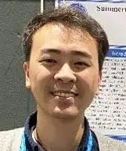
Our Team
Computational Oceanography Lab
We are a research group led by Dr. Yun Li in the School of Marine Science and Policy at the University of Delaware. Our research involves developing, coupling and implementing physical-biogeochemical numerical models to identify key drivers, influence pathways and consequences of marine ecosystem variability, with focus on the “bottom-up” effects cascading from physical environment (e.g., stratification, circulation, sea ice) to primary production and the food web.
Previous Summer/Winter Student Graduate Student Postdoc
Nathan Shunk Kristie Arlotta Rebecca Mezei Tianyu Zhou Thomas Daley Zhangxian Ouyang

Slide 3




Biosketch
Research Interests
coupled physical-biogeochemical model
stratification and circulation
oxygen dynamics
sea ice and phytoplankton phenology
biophysical interaction
Top Predators
(e.g., fish, seabird)
Zooplankton
Phytoplankton
Nutrients
Light, Oxygen
Physics
Notes:
PhD + phytoplankton

Slide 4
Outline
Background: Environmental Variability
Overview: Coastal Ecosystem and Modeling
Lessens: Hypoxia in Chesapeake Bay
Success: Ecosystem Application
New Development: Ongoing work on coastal modeling
Notes:
Less than 20% of surface area, yet play disproportionally large role
3. e.g., pollution, eutrophication, overfishing, habitat degradation

Slide 5
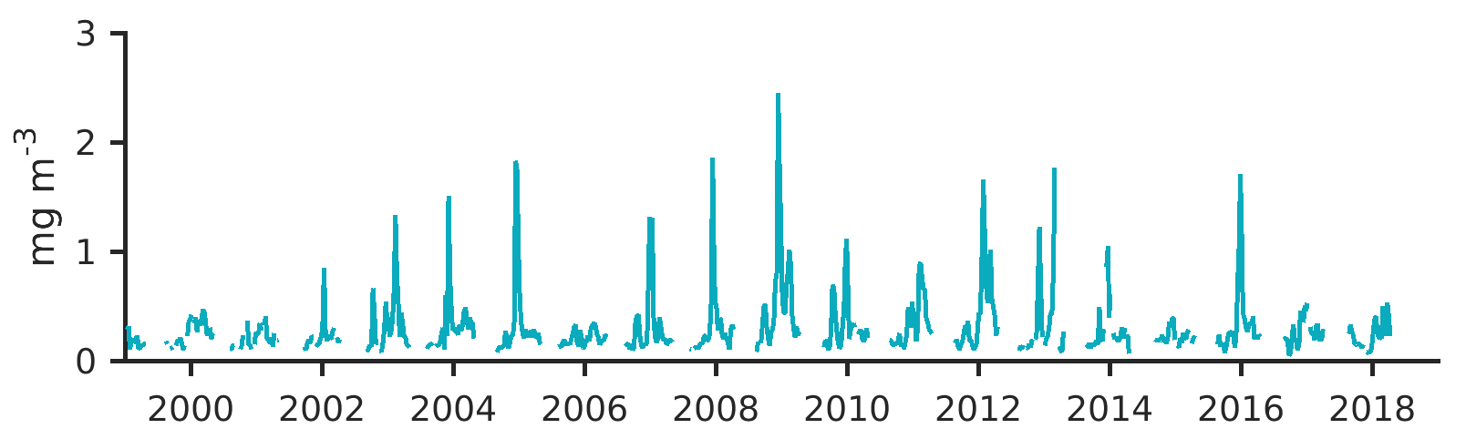
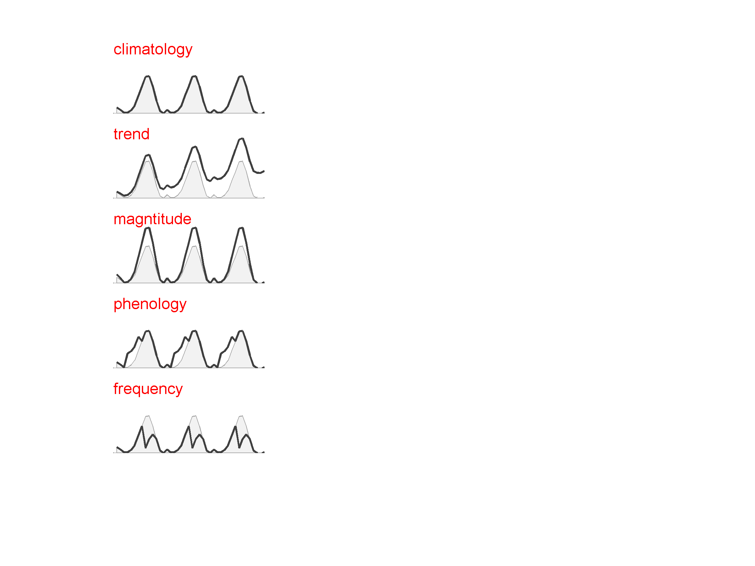
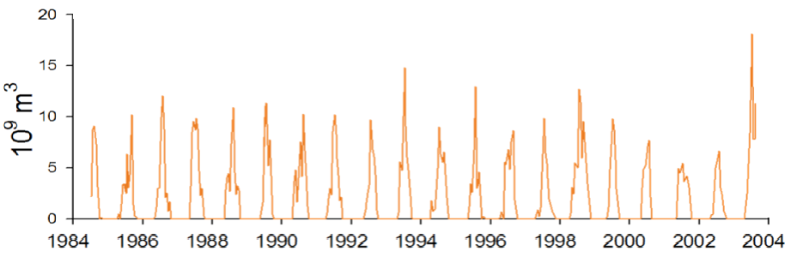

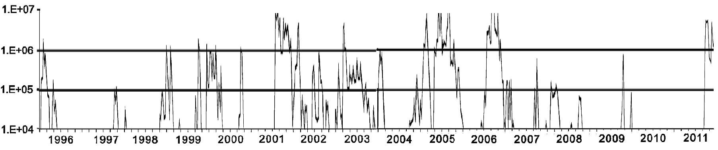
Changing Seasonality in Coastal Oceans
Surface Chlorophyll in the Antarctic
Hypoxic Volume in Chesapeake Bay
Karenia brevis conc. on the West Florida Shelf
Cell L⁻¹

Slide 6
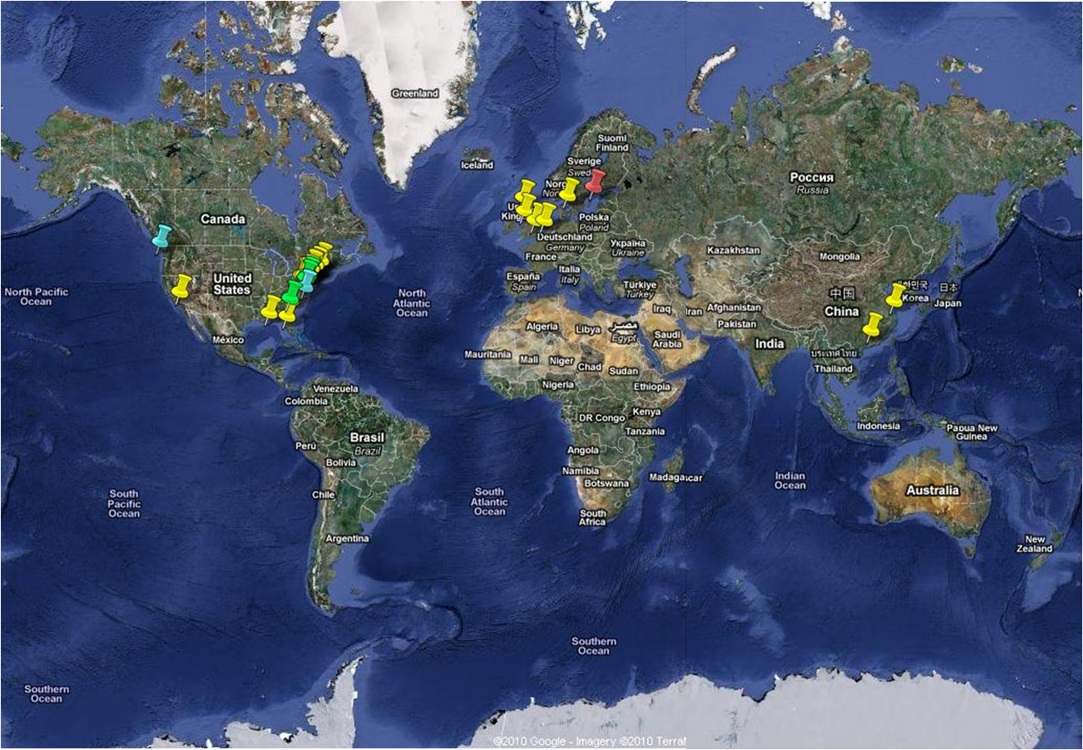
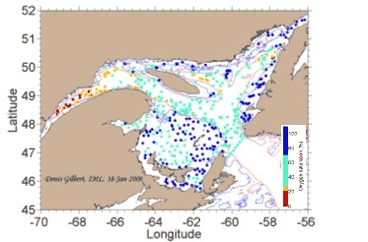

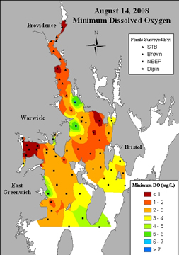
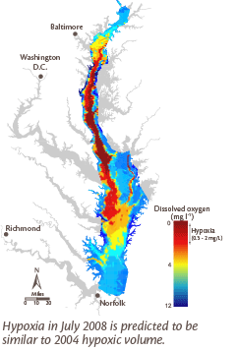
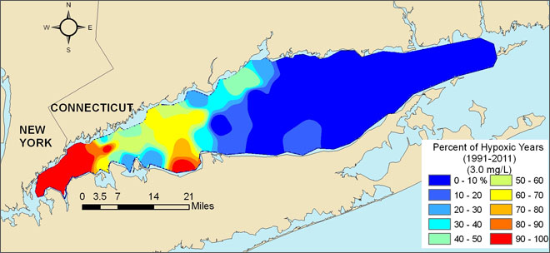
Types of Coastal Hypoxia
St. Lawrence Estuary
Permanent
Seasonal
Episodic
Diel
(Kemp et al. 2009)
Narragansett Bay
Chesapeake Bay
West Long Island Sound
Notes:
The occurrence of hypoxia varies in time and space. Based on duration and dominant time-scales, four broad categories are defined. Amongst those, seasonal hypoxia is most-studied. Many North American estuarine bottom waters suffer from
seasonal hypoxia, including St. Lawrence, Estuary, Narragansett Bay, West Long Island Sound and Chesapeake Bay. In these
semi-enclosed estuaries and bays, the processes controlling the seasonal DO cycle are similar.

Slide 7
Biological and Physical Controls
Imbalance between physical control and biological control contributes to changes in seasonality
Phenology
  - Sverdrup hypothesis (Sverdrup, 1953)
  - Disturbance-recovery hypothesis (Behrenfeld, 2010)
  - Critical mixing hypothesis (Townsend et al., 1992)
Species composition
  - Magalef’s Mandala (1979)
P
Z
grazing
mixing & advection
connectivity
Physics
respiration
respiration
uptake
mortality
mortality
mixing & advection
connectivity
N
D
remineralization
C cycle (physical pump vs. biological pump)
N cycle (new vs. recycled)
O₂ budget (replenishment vs. utilization)

Slide 8
Questions and Approaches
What are the spatial and temporal patterns?
  - Are observations available to quantify the patterns?
  - Can we explain the patterns using hypothetical concepts?
What are the key drivers and dynamics that
control the changes?
    - Can we isolate the effects of natural and
  anthropogenic stressors?
  - What are the dominant influence pathways among
  biological and physical controls?
What are the implications for ecosystem management?
  - What strategies can we use to mitigate climate impacts?
  - Can we improve the projection of future scenarios?
Management
Projection
Model
interpret
construct
constrain
test
design
Observations
Hypotheses & Theories
derive

Slide 9
Ecosystem Modeling
Criteria | Description
Configuration | analytical, statistical, numerical
Dimension | 0D, 1D, 2D, 3D
Scale | regional and global
Resolution | low, medium, high
Complexity | simplified, moderate-, and full-dynamics
Components | nutrients, phytoplankton, zooplankton, detritus, etc.
Coupling | offline (soft), online (hard)
Data constraint | data-assimilative and free-running
Trophic level | lower, higher or multiple
Water column zone | pelagic, benthic or both
Life traits | individual-based, population-based
… | …

Slide 10
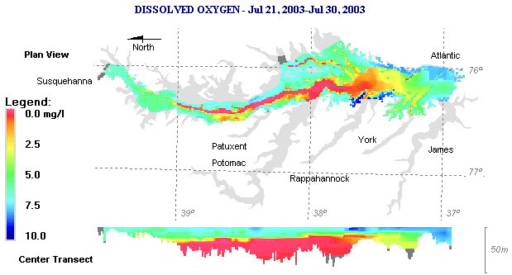
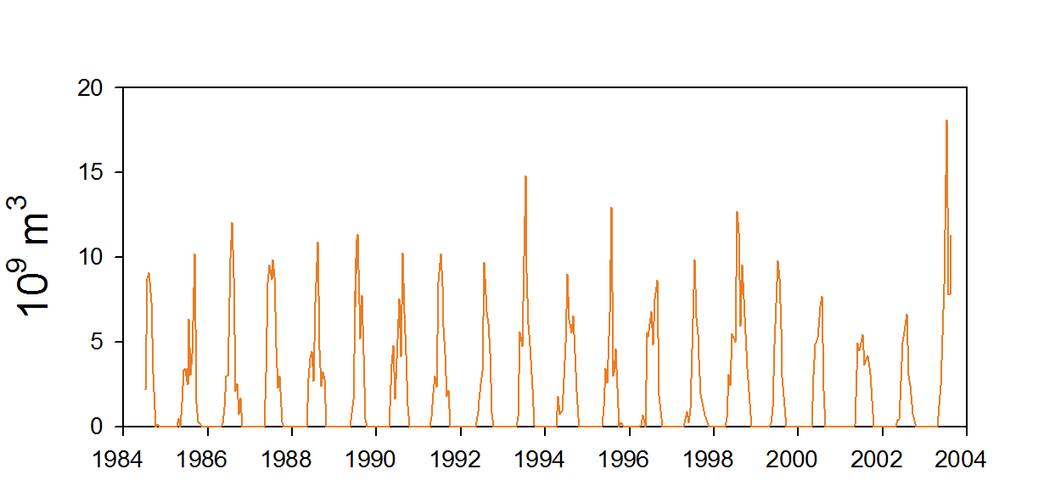
Seasonal Hypoxia In Chesapeake Bay
Occur in the deep channel in the mainstem.
Strong seasonal cycle and large interannual variability
Hypoxic Volume (km³)
Notes:
Observational data from 1984 to now shows that hypoxia develops every summer. It occupies the deep channel in the mid-bay region. One of most extensive hypoxia occured in year 2003. Besides seasonal cycle, large interannual variability is found.

Slide 11
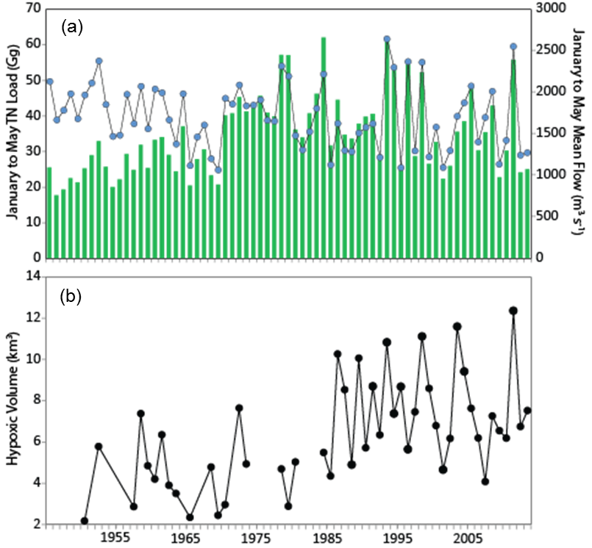
Long-term Trend and Seasonal Variability
Jan-May TN-loading (Gg)
Jan-May river flow (m³s⁻¹)
Long-term eutrophication
Regime shift: stronger magnitude and larger variability of summer hypoxia after 1970s.
Sever(moderate) hypoxia in wet (dry) years, indicative of links to river runoff and nutrient loading (Hagy et al., 2004).
Hypoxic Volume (km³)
wet year
dry year
Notes:
Historically, the hypoxia research has focused on eutrophication effects. It is widely believed that anthropogenic nutrient enrichment fuels algal growth and oxygen depletion in bottom waters. In the Bay, the nutrient loading increased 2-3 fold between 1950s and 1980s, and hypoxic volume has a similar trend during the same period. Despite major public commitments to reduce nutrient input, and despite that the nutrient loading is leveled off or reduced, hypoxic volume continues to increase, with significant variations over the past couple of decades: with severe hypoxia in wet years and mild hypoxia in dry years
Unlike tampa bay that is seeing improved water quality since nutrient regulations were established

Slide 12
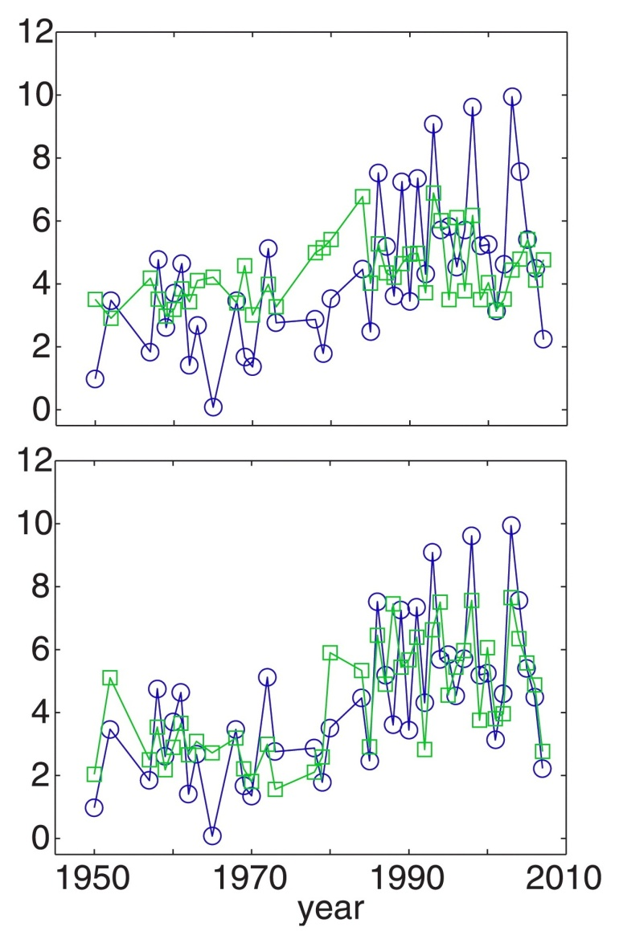
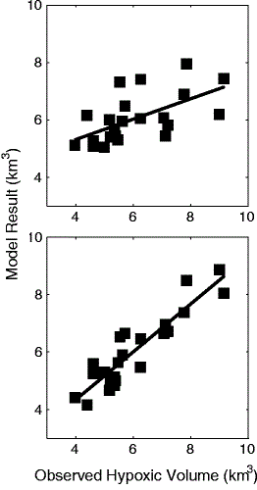
Climate-Induced Changes in River and Wind
TN
r²=0.20, p<0.01
River
r=0.60, p<0.01
Hypoxic volume (km³)
Predicted volume (km³)
Scully (2010) Lee et al. (2015)
observed volume (km³)
Significant fraction of interannual variability is explained by wind.
Notes:
A major impediment to developing successful restoration strategy is the complicating effect of climate variability due to highly variable river discharge and wind conditions. More recently, two studies reported that, beside riverine nutrient input or river flow, adding wind as another predictor that will significantly improve the regression relationship.

Slide 13
Climate-Induced Changes in River and Wind
TN + Wind
r²=0.62, p<0.01
River + Wind
r=0.91, p<0.01
Hypoxic volume (km³)
Predicted volume (km³)
Scully (2010) Lee et al. (2015)
observed volume (km³)
Significant fraction of interannual variability is explained by wind.
Notes:
A major impediment to developing successful restoration strategy is the complicating effect of climate variability due to highly variable river discharge and wind conditions. More recently, Scully (2010) demonstrated that some of the internannual variations unaccounted for by nitrogen loads can be explained by summer winds. Similarly, Lee et al. (2015) reported spring wind as another predictor that will significantly improve the regression relationship.

Slide 14
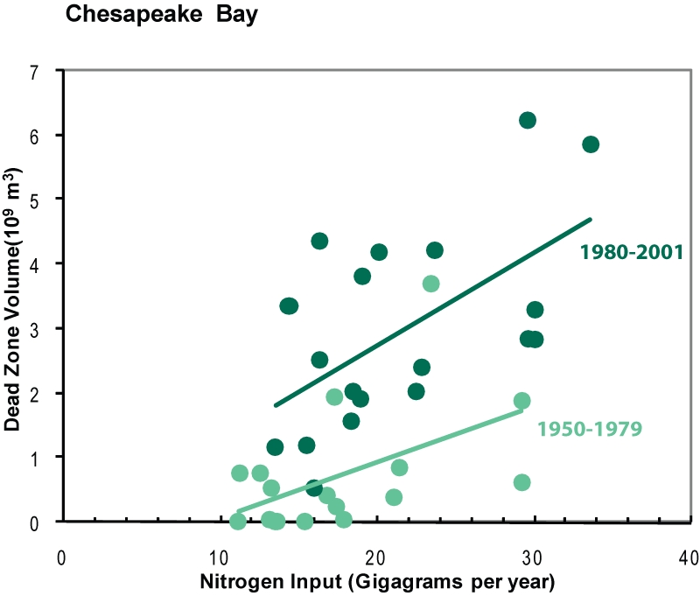
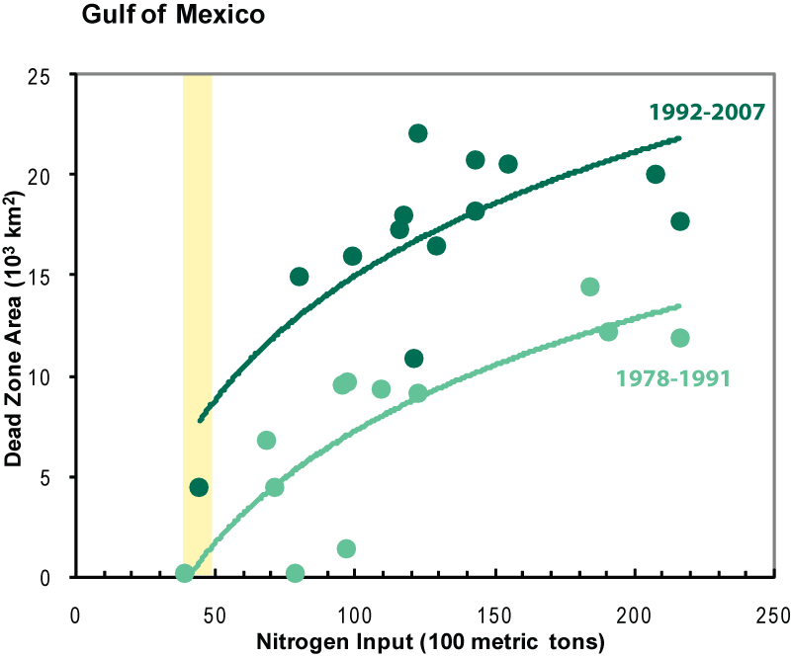
Regime Shift?
same nutrient input grows larger hypoxic zone in recent decades
shift in climate conditions and/or biogeochemical regime.
Chesapeake Bay Gulf of Mexico
Hypoxic Volume (km³)
Hypoxic Area (1000 km²)
Data after Hagy et al. (2004) for CB and Turner et al. (2008) for GOM
Notes:
Even though nutrient input can be reduced to the low levels same as decades ago, each unit amount of nutrients now can “grow” more hypoxia , suggesting likely shifts in biogeochemical regime or changes in climate conditions.

Slide 15
Seasonal Oxygen Dynamics in Estuaries
Partially-mixed estuary (Hansen and Rattray, 1965)
Estuarine along- and cross-channel exchange flow (Li and M. Li, 2011; 2012)
Seasonal addition of riverine nutrients and buoyancy
River
air-sea exchange
(e.g. Kemp et al. 1992)
nutrients and buoyancy
phytoplankton bloom
(e.g., Tyler and Seliger 1978; Cloern 1991)
vertical exchange
(e.g. Wilson et al. 2008)
Hypoxia
horizontal exchange
(e.g. Boicourt et al. 1992)
Notes:
Spring river flow that delivers nutrients and buoyancy, increasing temperature stimulates phytoplankton to grow. After they die,. They sink to bottom waters and the respiration of organic matter causes the drowndown of oxygen in bottom waters. Physical processes such as stratification that suppresses vertical oxygen exchange, and transport of oceanic oxygen, are also responsible.
Chesapeake Bay provides a good case study to study hypoxia, not only because various physical and biogeochemical processes interact to regulate the development of seasonal hypoxia, but also because its long-term monitoring program that provide valuable data for understanding those processes.

Slide 16
What are Key Processes?
physical
biogeochemical
Study | Longi-tudinal | lateral | diffusive | air-sea | Photo- synthesis | pelagic resp. | benthic resp.
Officer et al., 1984
Malone et al., 1986*
Sanford and Boicourt, 1990*
Kemp et al., 1992*
Boicourt, 1992*
Scully, 2010
No general agreement
Infer different oxygen dynamics and system sensitivity

Slide 17
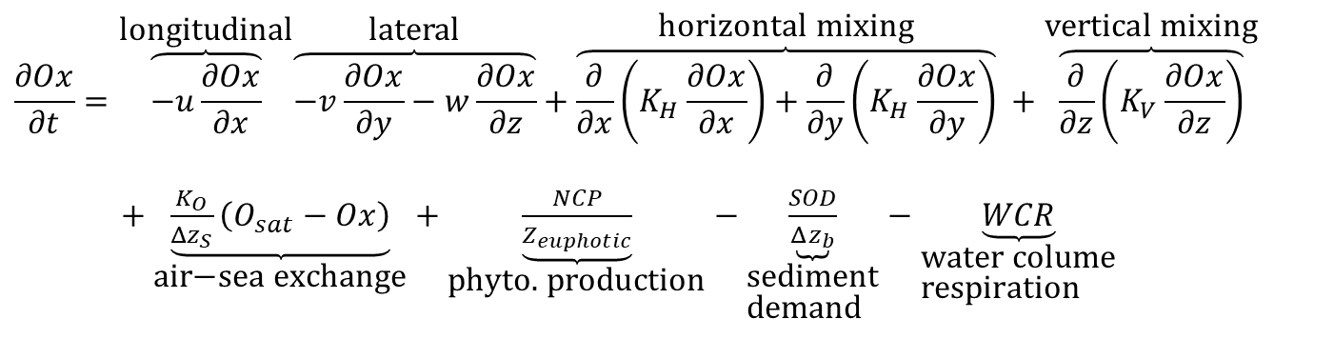
Modeling Dissolved Oxygen Dynamics
$$\frac{∂Ox}{∂t}=\overset{\text{longitudinal}}{\overbrace{−u\frac{∂Ox}{∂x}}}\overset{\text{lateral}}{\overbrace{−v\frac{∂Ox}{∂y}−w\frac{∂Ox}{∂z}}}+\overset{\text{horizontal} \text{mixing}}{\overbrace{\frac{∂}{∂x}\left(K_{H}\frac{∂Ox}{∂x}\right)+\frac{∂}{∂y}\left(K_{H}\frac{∂Ox}{∂y}\right)}} +\overset{\text{vertical} \text{mixing}}{\overbrace{\frac{∂}{∂z}\left(K_{V}\frac{∂Ox}{∂z}\right)}}$$
$+\underset{\text{air}\text{−}\text{sea} \text{exchange}}{\underbrace{\frac{K_{O}}{Δz_{S}}\left(O_{sat}−Ox\right)}}+\underset{\text{phyto}\text{. }\text{production}}{\underbrace{\frac{NCP}{Z_{euphotic}}}}−\underset{\begin{aligned}&\text{sediment} \\ &\text{demand}\end{aligned}}{\underbrace{\frac{SOD}{Δz_{b}}}}−\underset{\begin{aligned}&\text{water} \text{colume} \\ &\text{respiration}\end{aligned}}{\underbrace{WCR}}$
Physical controls
Biological controls
Li et al. (2015)
Objectives: Use coupled physical-biogeochemical model to underpin dominant drivers that affect hypoxia seasonality
Notes:
Chesapeake Bay is located
about 300 km long and 5~20 km wide. Earth’s rotation effect is important because interal Rossby radius is less than the width at most places. The Bay is flanked by broad shallow shoals with a deep narrow central channel continuous over much of its length. It receives more than half of fresh water from the Susquehanna River at the northern end and all salt input from the shelf through the southern entrance. The competition between salt and fresh water builds up a partially-mixed pattern which features a pycnocline and a two-layer circulation in the estuary. Deep water in the middle part of the Bay becomes hypoxic every summer.
Stratification
Two-layer circulation
Wind-induced lateral circulation

Slide 18
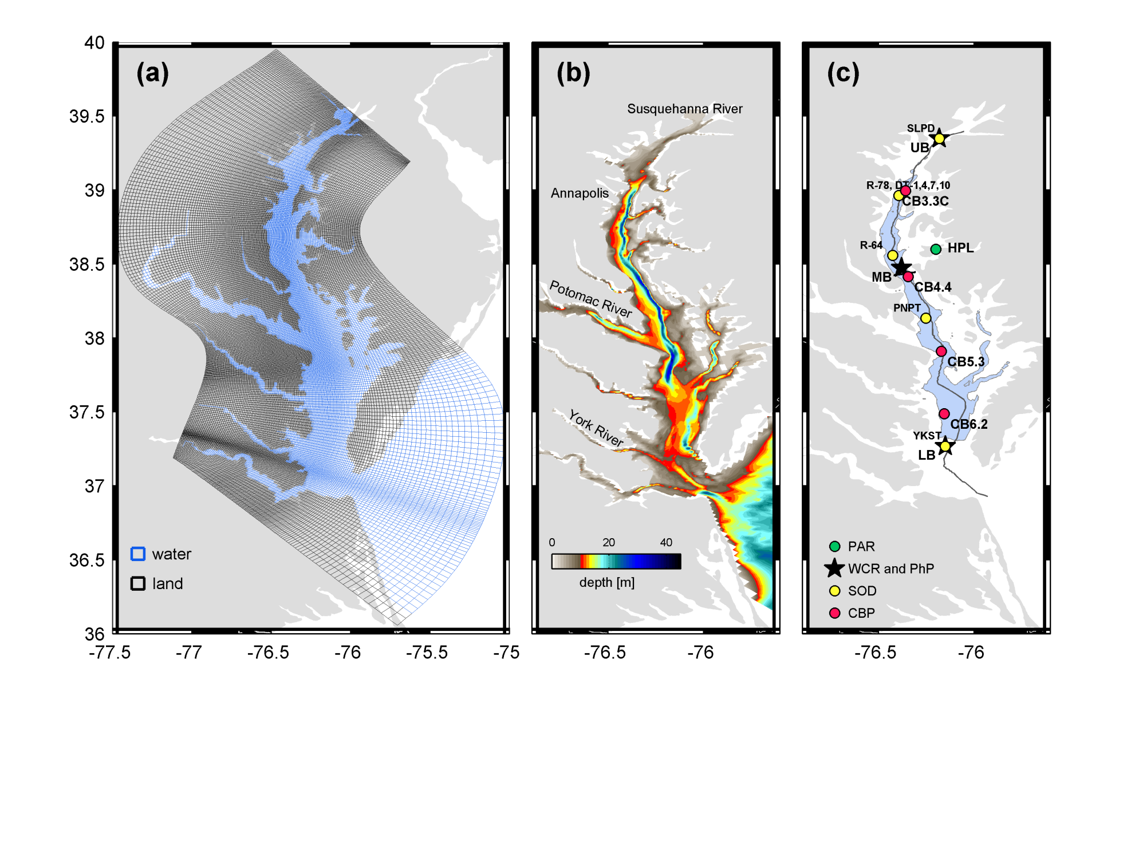
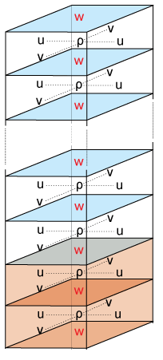
Hydrodynamic Module
A high-resolution Regional Ocean Modeling System (ROMS) model to simulate 3D hydrodynamics
Horizontal curvilinear, Arakawa C-grid with the finest resolution at 500 m
Vertical-stretched, terrain-following coordinate of 20 layers with high-resolution near surface and bottom
Forced by tides, non-tidal sea level, wind, heat and freshwater fluxes
20 pelagic layers
2 benthic layers
Li et al. (2015)
Modified after wikiROMS

Slide 19
Biogeochemical Module
RCA model: 3 phytoplankton groups, 5 nutrients N, P, Si, C and O₂, and sediment diagenesis
Multiple-stressor limitation on phytoplankton growth
Temperature-dependent, concentration-based chemical reaction rates.
air-sea exchange
light (PAR)
RCA Model
nitrification
DIN
(NH₄, NO₂, NO₃)
DON & PON
photosynthesis
oxygen
phytoplankton
DIP
(PO₄)
DOP & POP
respiration
oxidation
DSi
(SiO₂)
Biogenic Si
POC & DOC
settling
settling
settling
sediment N, P, Si
Testa et al. (2014 and 2017)**
Notes:
Chesapeake Bay is located
about 300 km long and 5~20 km wide. Earth’s rotation effect is important because interal Rossby radius is less than the width at most places. The Bay is flanked by broad shallow shoals with a deep narrow central channel continuous over much of its length. It receives more than half of fresh water from the Susquehanna River at the northern end and all salt input from the shelf through the southern entrance. The competition between salt and fresh water builds up a partially-mixed pattern which features a pycnocline and a two-layer circulation in the estuary. Deep water in the middle part of the Bay becomes hypoxic every summer.
Stratification
Two-layer circulation
Wind-induced lateral circulation

Slide 20
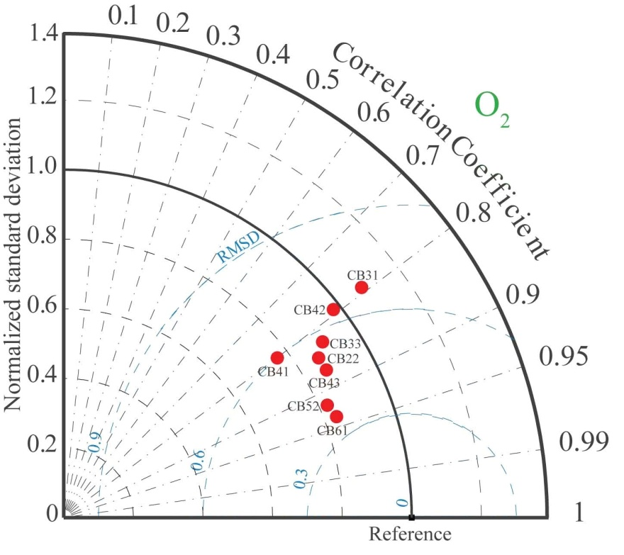
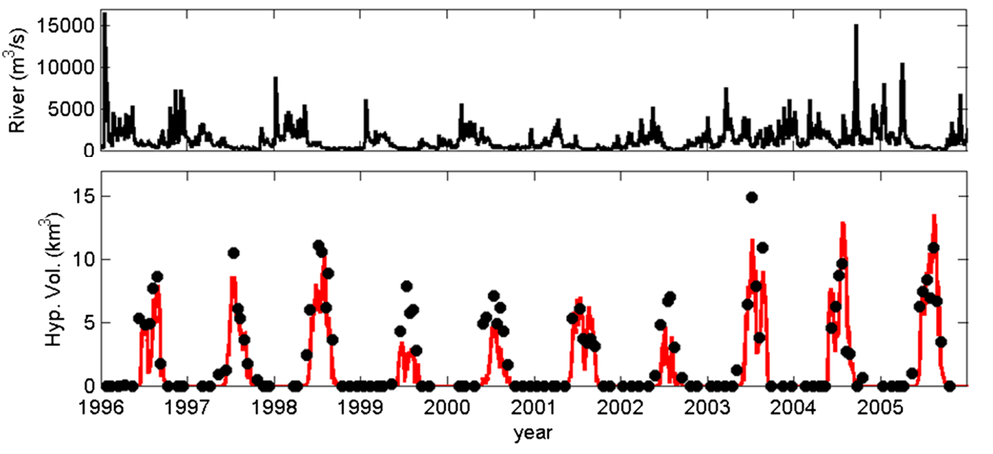
Changes in Seasonality
The coupled ROMS-RCA generally reproduces the changes in seasonality with reasonable skill
The model resolves the synoptic variability that is absent in observations
(Li et al., 2016)**
(Testa et al., 2014)**

Slide 21
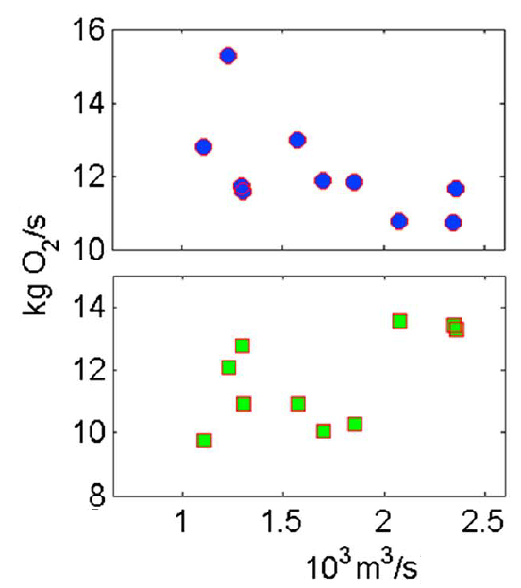
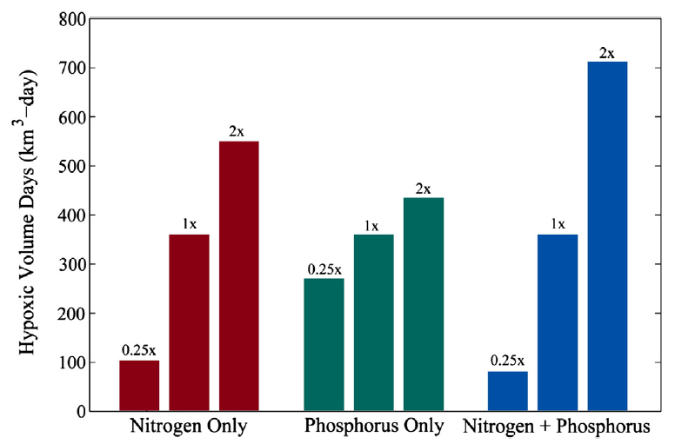
Changes in Seasonality (cont’d)
Not sensitive to riverine buoyancy, due to the compensation between advection and mixing effects.
Sensitive to riverine N loading through water-column respiration
Nonlinear response to wind-induced advection and mixing.
Riverine Buoyancy
Riverine Nutrients
Wind
× 0.5
CTRL
×2
Mixing
Advection
mixing
runoff
(Li et al., 2016) **
(Testa et al., 2014)**
(Li et al., 2015)
Notes:
because of the compensation between flow-induced advection and mixing-induced vertical exchange.

Slide 22
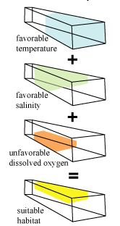
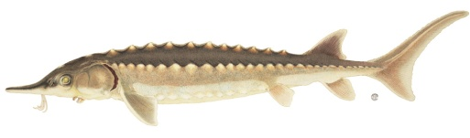
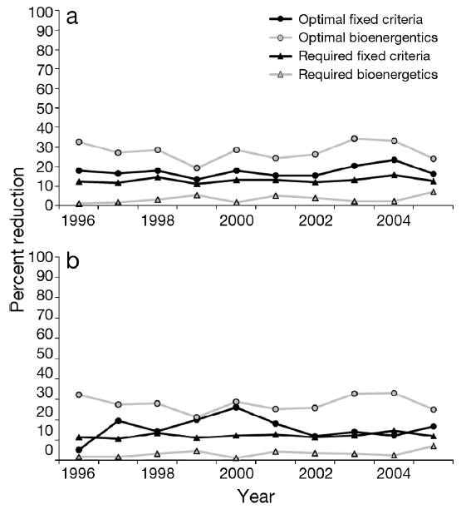
Link DO to Fish Habitat
3D Habitat Suitability Model Percentage Reduction due to Hypoxia
young-of-the-year
Atlantic Sturgeon
yearling
fixed criteria
bioenergetics
(Schlenger et al., 2013)**

Slide 23
Summary
  Nutrients and winds are responsible for changes in hypoxia seasonality.
  Coupled ROMS-RCA model can help
    – resolve synoptic variability that is not captured by observations.
    – isolate climate- and human-induced effects on DO.
    – understand and predict ecosystem shift
    – inform nutrient management and fishery habitat assessment.

Slide 24
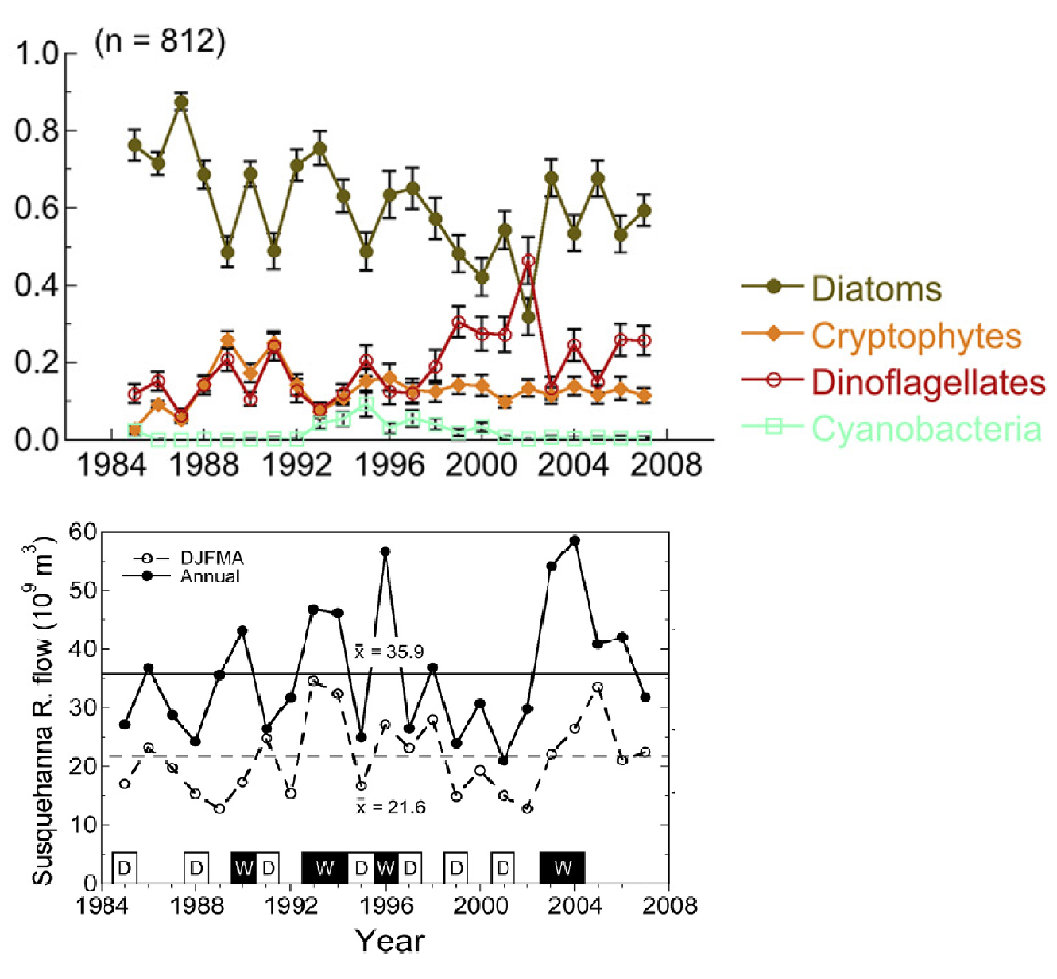
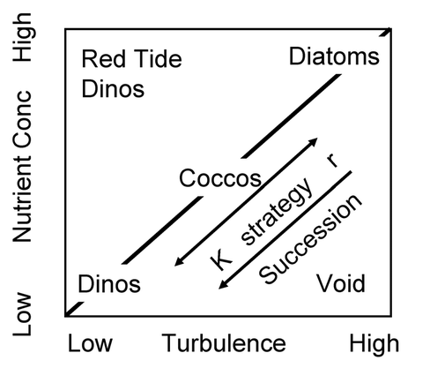
Ongoing: Phytoplankton Species Composition
Quantify the controls, timing, and biogeochemical impacts of shifting phytoplankton floral composition in a coastal ecosystem
Modified after Margalef (1978)

Slide 25
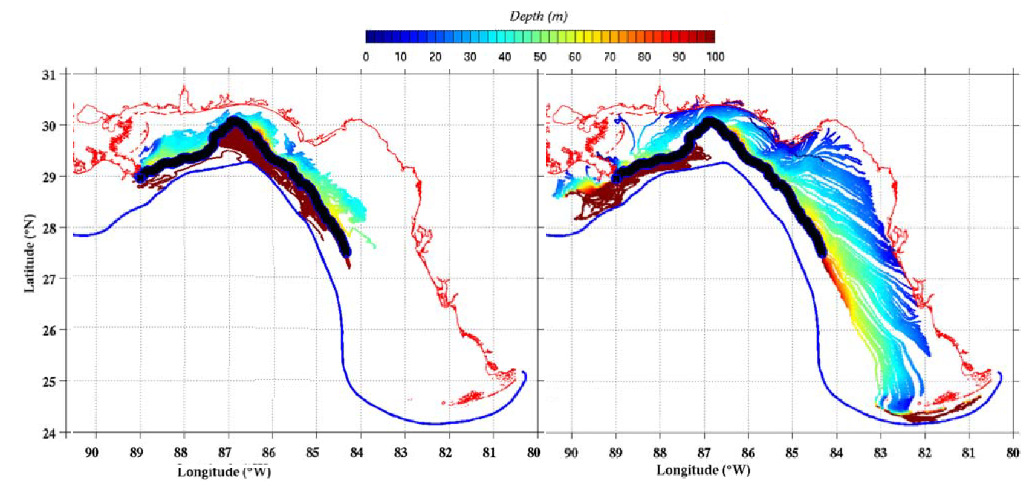
Occurrence of Red Tide on the WFS
Ongoing: Coastal Connectivity – Seasonal Occurrence of Red Tide (SORT)
Particle tracking model coupled with hydrodynamic-biogeochemical model to understand the sources and origins of HABs, pollutants, larvae transport in the dynamic coastal environmental.
(Weisberg et al., 2016)
Apr-May
Jun-Jul
Notes:
Spatial and temporal pattern

Slide 26
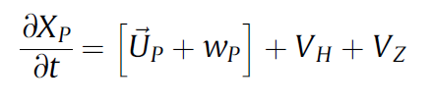
New Development of Ecosystem Modeling
Online Coupling to take advantage parallel computation and advanced schemes
Data Assimilation to use multi-steams datasets to improve model performance
Nesting and Hybrid to improve model versatility and connect time-space scales
Machine Learning to optimize parameterization and save human labor
Biogeochemical Model
Individual-based Model
‘‘particles’’ to represent marine organism & imbued with physics, organism behavior and traits
Lagrangian Particle Tracking + behavior
Phytoplankton traits (growth, mortality)
Testa et al. (2014)

Slide 27
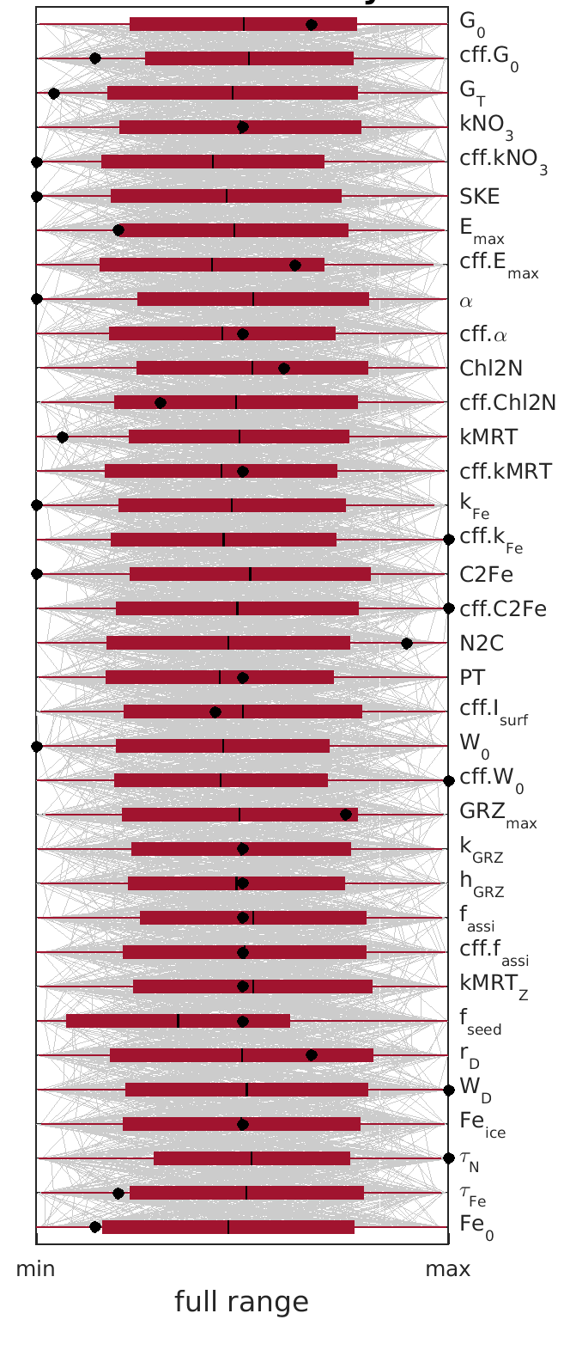
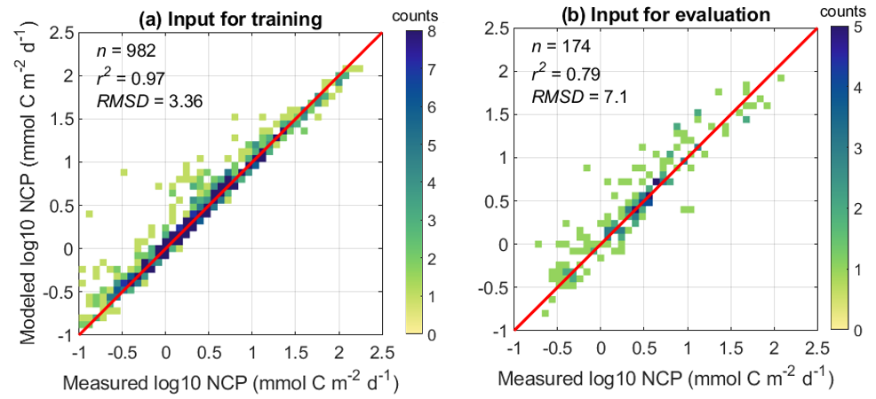
New Development of Ecosystem Modeling
Online Coupling to take advantage parallel computation and advanced schemes
Data Assimilation to use multi-steams datasets to improve model performance
Nesting and Hybrid to improve model versatility and connect time-space scales
Machine Learning to optimize parameterization and save human labor
Machine Supervised Parameterization and Parameter Selection

Slide 28
Thank you!

Slide 29
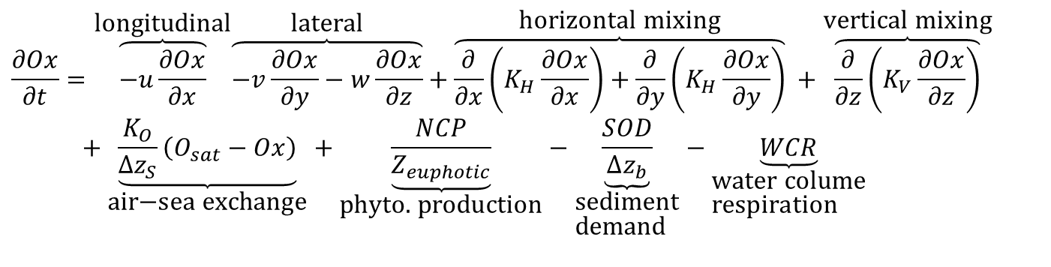
Modeling Dissolved Oxygen Dynamics
$$\frac{∂Ox}{∂t}=\overset{\text{longitudinal}}{\overbrace{−u\frac{∂Ox}{∂x}}}\overset{\text{lateral}}{\overbrace{−v\frac{∂Ox}{∂y}−w\frac{∂Ox}{∂z}}}+\overset{\text{horizontal} \text{mixing}}{\overbrace{\frac{∂}{∂x}\left(K_{H}\frac{∂Ox}{∂x}\right)+\frac{∂}{∂y}\left(K_{H}\frac{∂Ox}{∂y}\right)}} +\overset{\text{vertical} \text{mixing}}{\overbrace{\frac{∂}{∂z}\left(K_{V}\frac{∂Ox}{∂z}\right)}} \\ +\underset{\text{air}\text{−}\text{sea} \text{exchange}}{\underbrace{\frac{K_{O}}{Δz_{S}}\left(O_{sat}−Ox\right)}}+\underset{\text{phyto}\text{. }\text{production}}{\underbrace{\frac{NCP}{Z_{euphotic}}}}−\underset{\begin{aligned}&\text{sediment} \\ &\text{demand}\end{aligned}}{\underbrace{\frac{SOD}{Δz_{b}}}}−\underset{\begin{aligned}&\text{water} \text{colume} \\ &\text{respiration}\end{aligned}}{\underbrace{WCR}}$$
Li et al. (2015)
air-sea exchange
river
WCR
PhP
WCR
SOD
Notes:
Chesapeake Bay is located
about 300 km long and 5~20 km wide. Earth’s rotation effect is important because interal Rossby radius is less than the width at most places. The Bay is flanked by broad shallow shoals with a deep narrow central channel continuous over much of its length. It receives more than half of fresh water from the Susquehanna River at the northern end and all salt input from the shelf through the southern entrance. The competition between salt and fresh water builds up a partially-mixed pattern which features a pycnocline and a two-layer circulation in the estuary. Deep water in the middle part of the Bay becomes hypoxic every summer.
Stratification
Two-layer circulation
Wind-induced lateral circulation

Slide 30
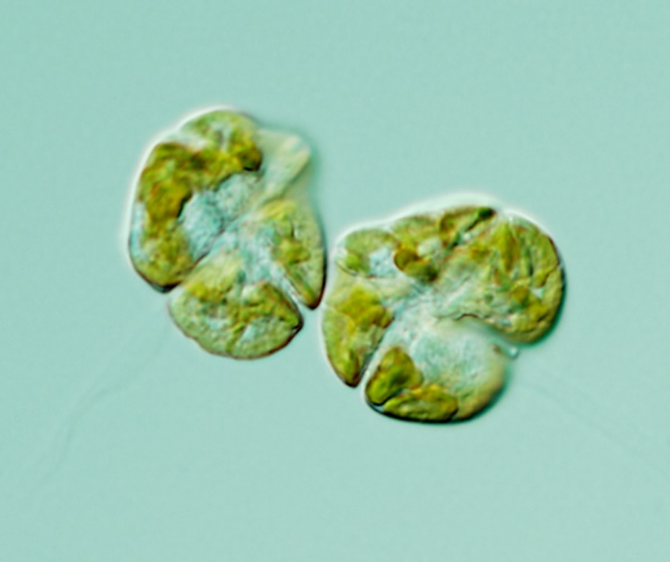
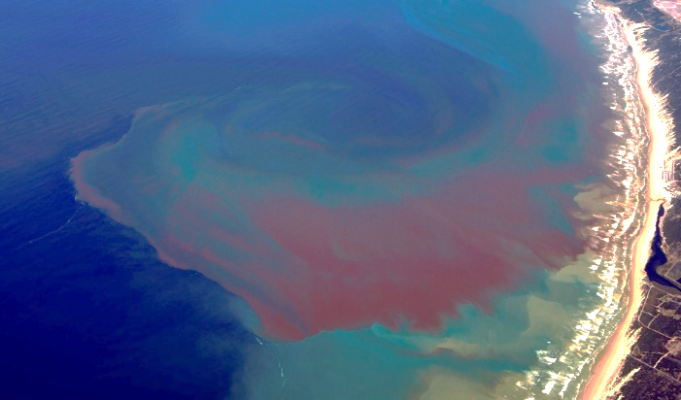
Red Tide Features
0 m
20 m
40 m
night day night day night day night
Image from Florida Fish and Wildlife Conservation Commission
(Hu et al, 2016)
Photo from https://frla.org/news-release/red-tide-emergency/
20-40 μm in diameter
0.2-1.0 divisions per day (in culture)
vertical swimming speed 2 m/hour
phototaxis and chemotaxis
Background level < 10 cell/L
bloom condition >10⁵ cell/L
Visible patches O(10~100) km
harmful brevetoxins to marine life and human

Slide 31
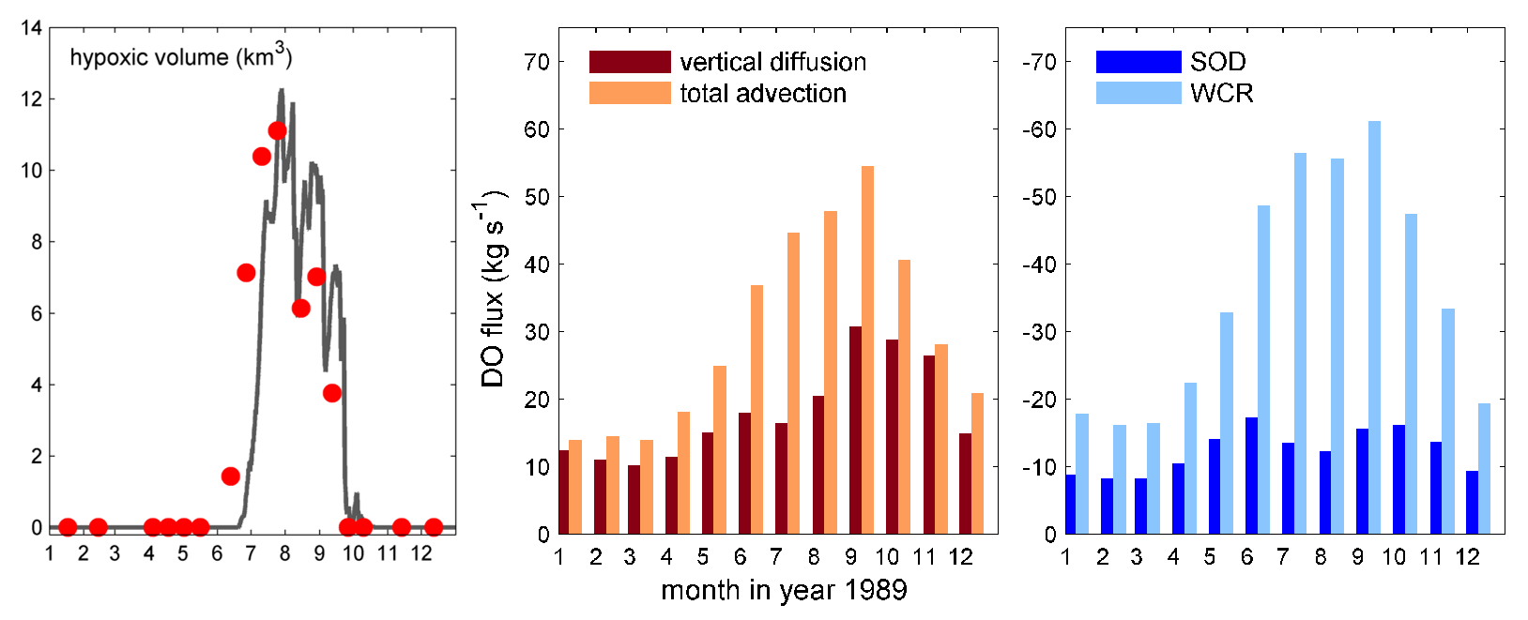
Biogeochemical Controls of Seasonality
Hypoxia initiates in late-June, peaks in August and terminates in October.
Advection (flow-induced) oxygen supply is stronger than vertical mixing-induced exchange.
Water column respiration plays more important role than sediment oxygen demand.
data
model
(Li et al., 2015)

Slide 32
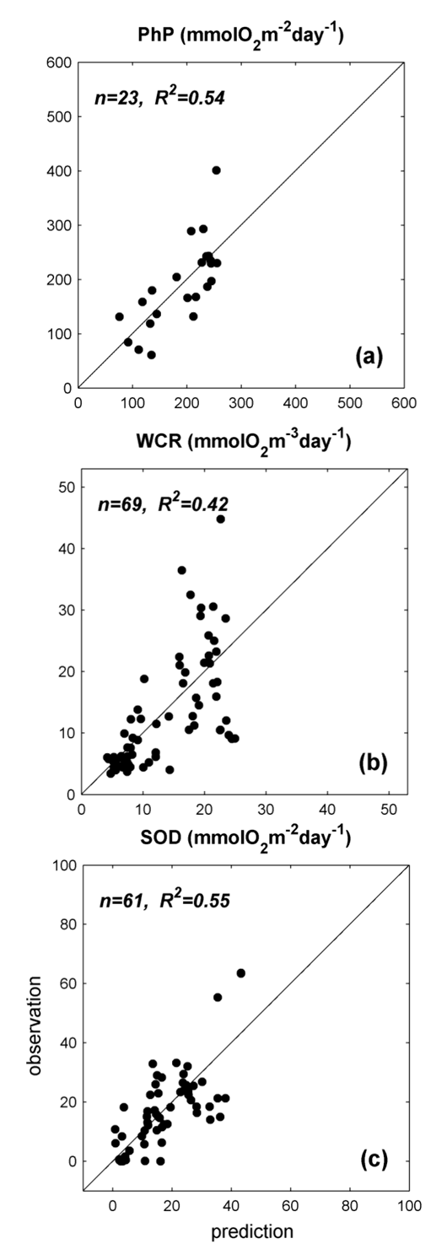
Biogeochemical Module
Simplified oxygen model: four biogeochemical processes for DO
Biogeochemical processes are parameterized as functions of known variables.
Isolate riverine nutrient input yet still consider seasonal evolution of oxygen sources/sinks
air-sea exchange
light (PAR)
$$PhP=31.25×(1.0101+ 0.0314PAR+0.1966T)$$
oxygen
utilization
PhP
(aka., net community production)
consumption
WCR
(e.g., oxidation, nitrification, bacteria)
sediment oxygen demand
Li et al. (2015)
Notes:
Chesapeake Bay is located
about 300 km long and 5~20 km wide. Earth’s rotation effect is important because interal Rossby radius is less than the width at most places. The Bay is flanked by broad shallow shoals with a deep narrow central channel continuous over much of its length. It receives more than half of fresh water from the Susquehanna River at the northern end and all salt input from the shelf through the southern entrance. The competition between salt and fresh water builds up a partially-mixed pattern which features a pycnocline and a two-layer circulation in the estuary. Deep water in the middle part of the Bay becomes hypoxic every summer.
Stratification
Two-layer circulation
Wind-induced lateral circulation

Slide 33
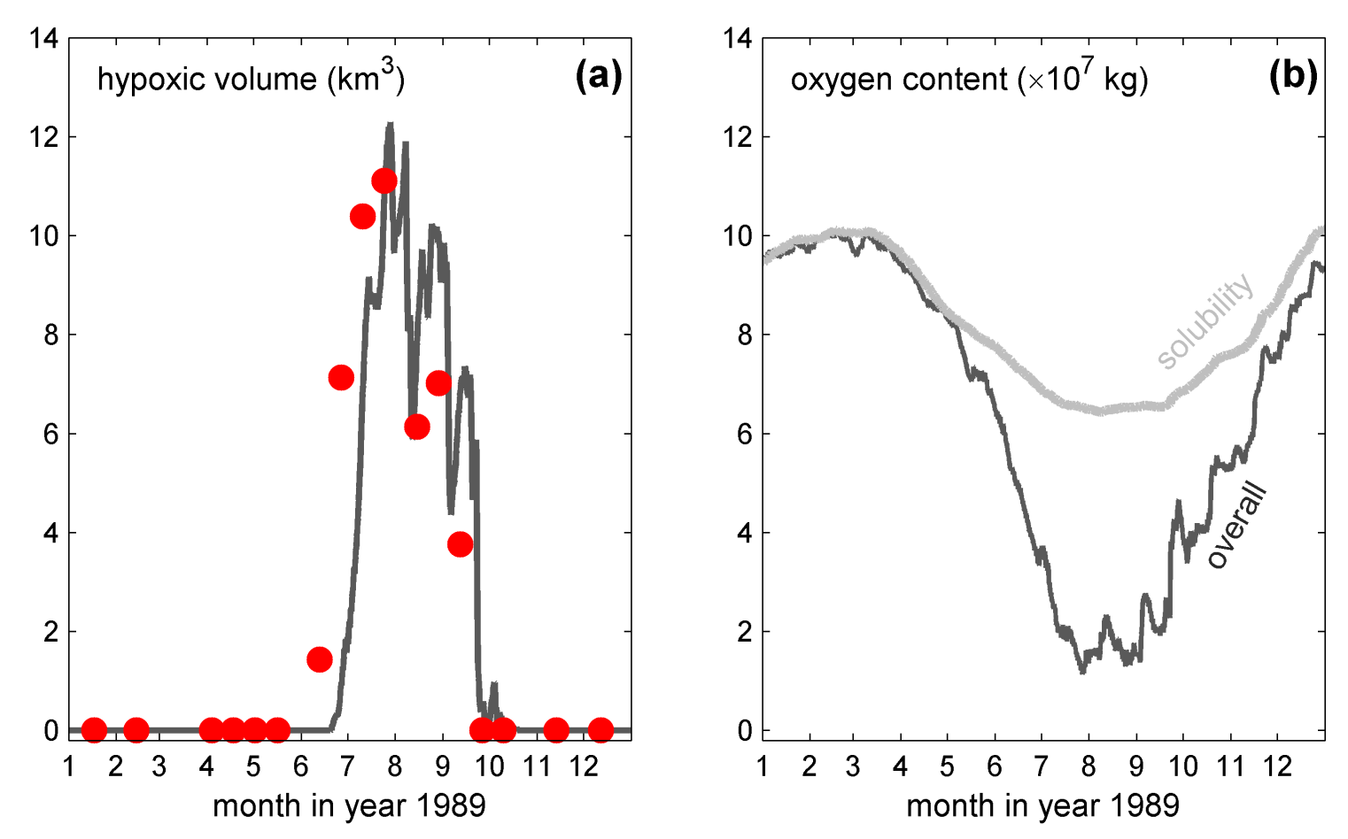
Seasonal Cycle of Oxygen Content
data
model
Hypoxic from June to September
Oxygen content follows solubility in spring, but becomes under-saturated in summer
(Li et al., 2015)

Slide 34
Sensitivity to wind and biogeochemistry
Hypoxia seasonality is not sensitive to river runoff
Seasonal timing of hypoxia is sensitive to wind-induced advection and mixing.
The magnitude of hypoxia is more sensitive to water-column respiration.
River ×0.5
CTRL
River ×2
Wind ×0.5
CTRL
Wind ×2
SOD only
CTRL
WCR only
(Li et al., 2015)
Notes:
because of the compensation between flow-induced advection and mixing-induced vertical exchange.

Slide 35
Key Processes in Controlling Bottom Oxygen
Physical biogeochemical
Physical processes all contribute to oxygen supply and are equally important
Biogeochemical processes are dominant by WCR in oxygen utilization

Slide 36
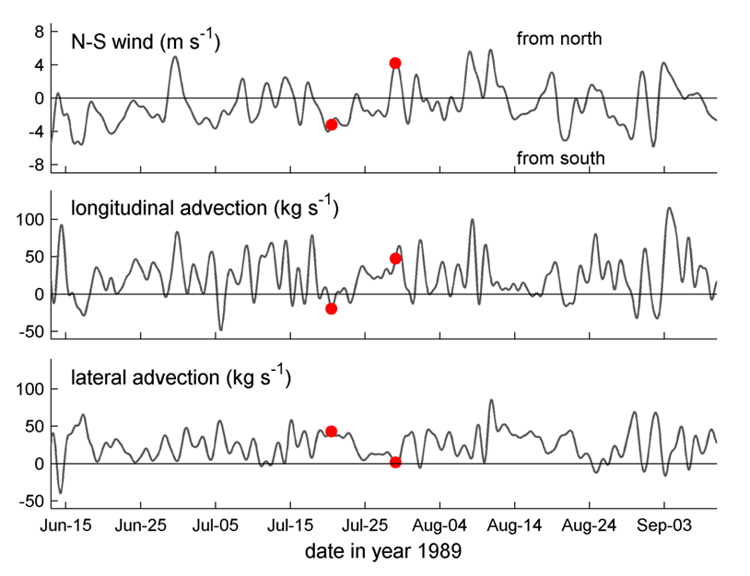
Drivers of Longitudinal and Lateral Fluxes
Compensatory changes between longitudinal and lateral fluxes
Wind-dependent responses
(Li and Li, 2011 & 2012; Li et al., 2015)

Slide 37
Seasonal Hypoxia in Chesapeake Bay
Occur in the deep channel in the mainstem.
Strong seasonal cycle and large interannual variability
Hypoxic Volume (km³)
Notes:
Observational data from 1984 to now shows that hypoxia develops every summer. It occupies the deep channel in the mid-bay region. One of most extensive hypoxia occured in year 2003. Besides seasonal cycle, large interannual variability is found.

Slide 38
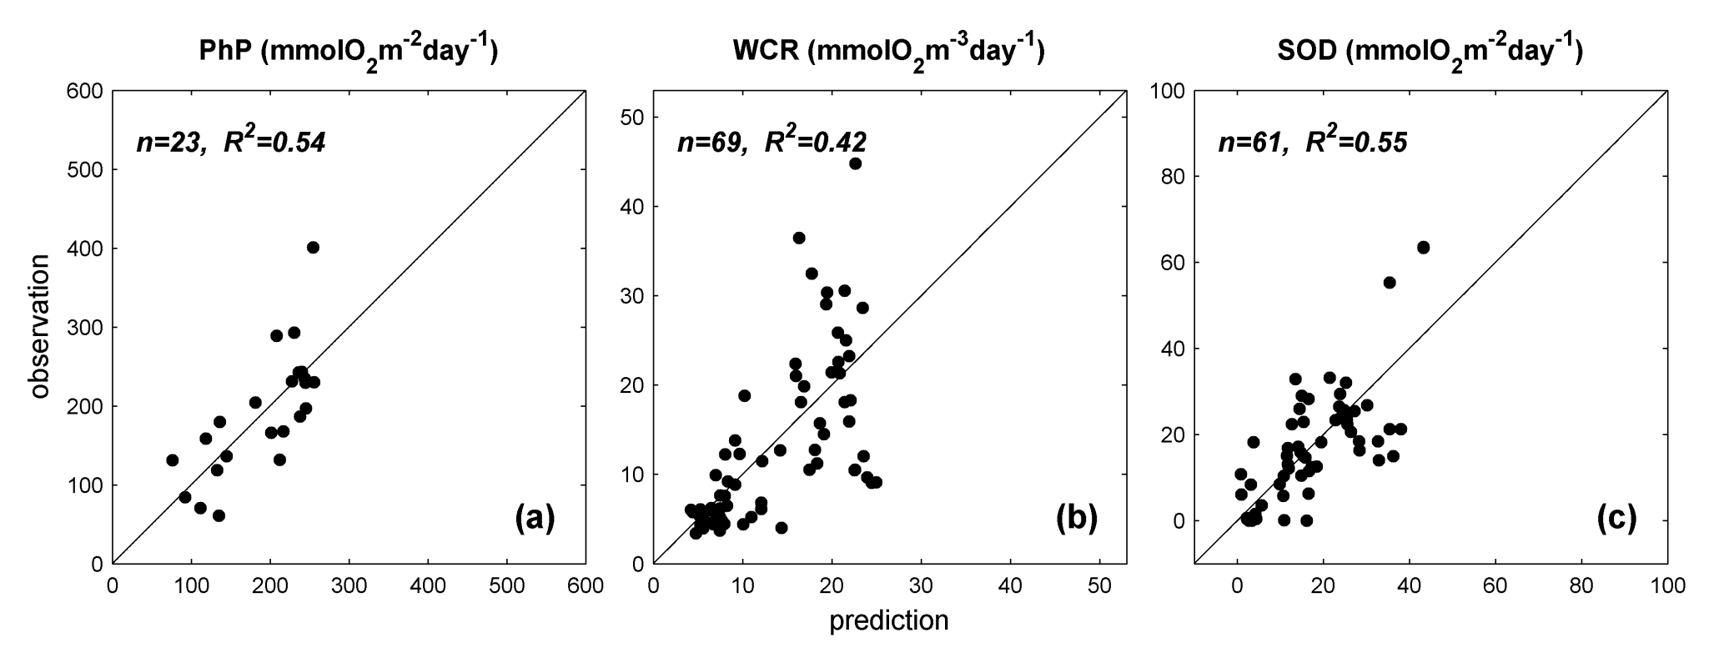
Parametrization (simplified)
(Li et al., 2015)
Phytoplankton Production
Water Column Respiration
Sediment Oxygen Demand

Slide 39
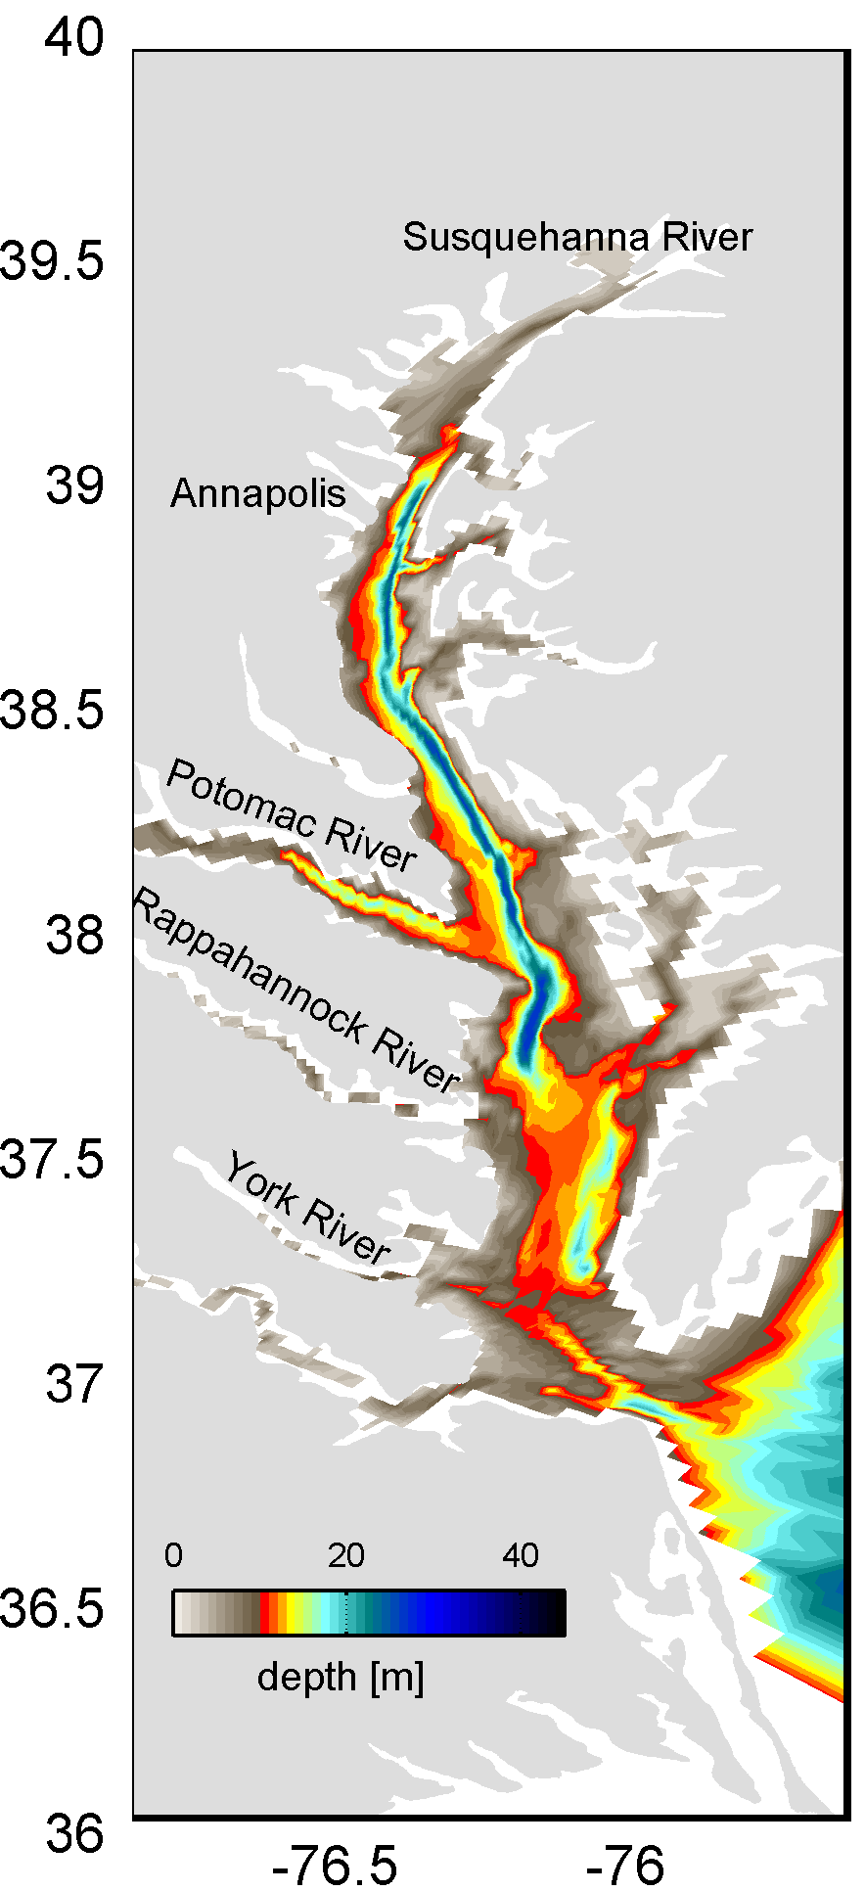
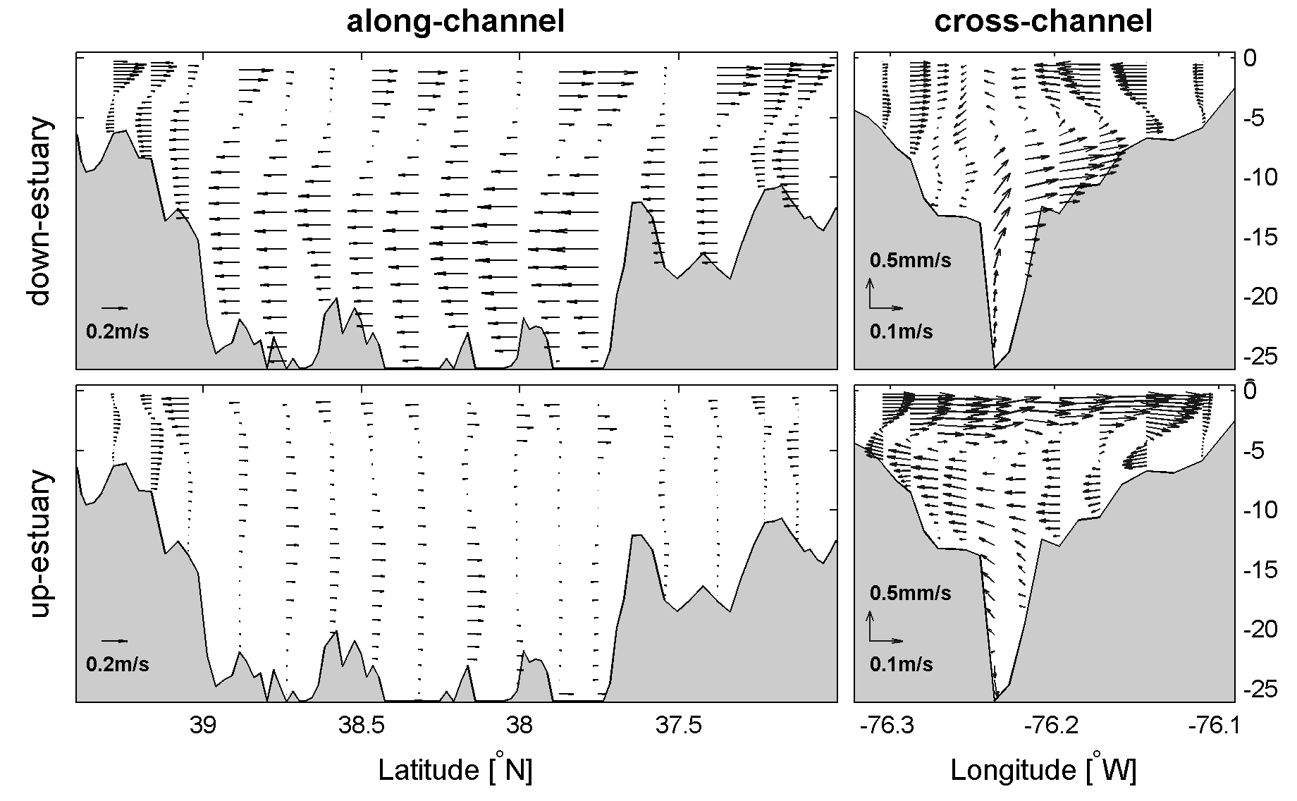
Complexity in Physical Processes
300 km
15 km
river ocean
Largest estuary in the U. S.
Partially mixed
3D circulation
Notes:
Chesapeake Bay is located exaplain the lateral and longitudinal definition
about 300 km long and 5~20 km wide. Earth’s rotation effect is important because interal Rossby radius is less than the width at most places. The Bay is flanked by broad shallow shoals with a deep narrow central channel continuous over much of its length. It receives more than half of fresh water from the Susquehanna River at the northern end and all salt input from the shelf through the southern entrance. The competition between salt and fresh water builds up a partially-mixed pattern which features a pycnocline and a two-layer circulation in the estuary. Deep water in the middle part of the Bay becomes hypoxic every summer.
Stratification
Two-layer circulation
Wind-induced lateral circulation

Slide 40
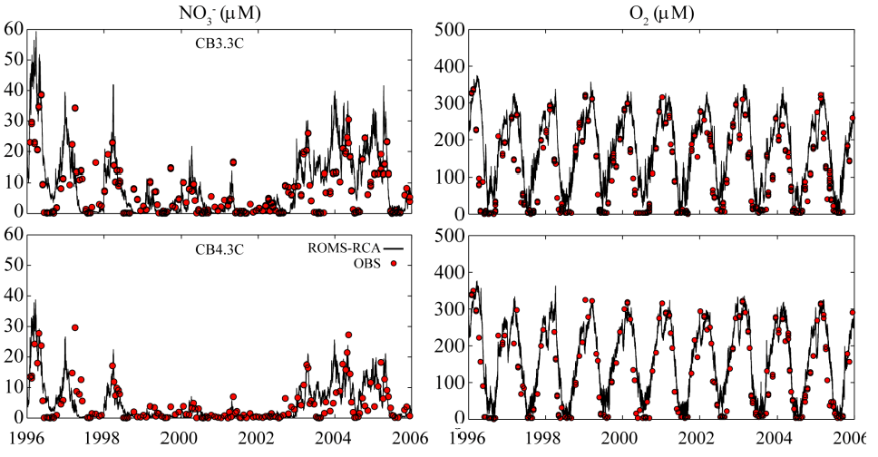
Model-Data Comparison
Model reproduces the interannual changes of nutrients and oxygen
(Testa et al., 2015, co-author)

Slide 41
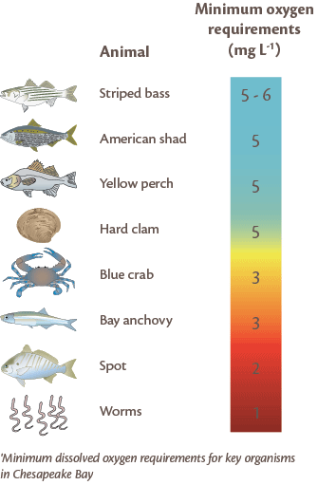
Hypoxia – What is it?
Dissolved oxygen (DO) concentrations fall below a threshold that interrupts normal metabolism of marine organisms.
DO (mg L⁻¹) | Type
2.0 | hypoxia
1.0 | sever hypoxia
0.2 | anoxia
Notes:
Hypoxia is usually defined as dissolved oxygen (DO) concentrations falling below approximately 2mgL⁻¹ that interrupts normal metabolism of marine organisms. Other commonly used criteria are 1mgL⁻¹ for sever hypoxia and 0.2mg/L for anoxia.

Slide 42
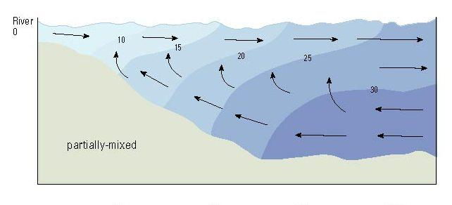
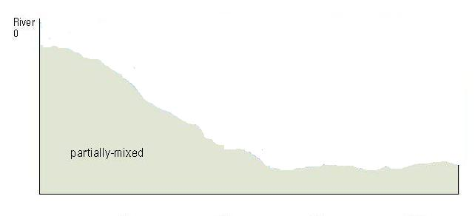
Physical and Biogeochemical Controls
River
Ocean
salinity
high salinity
air-sea exchange
oxygen
high oxygen
pelagic and benthic respiration
Notes:
Interannual changes of hypoxia is caused by hydrodynamic and biogeochemical controls. In a partially-mixed, oceanic input of high-oxygen water is an source, but unlike, high oxygen water is stacked on top of oxygen-poor water, making an inversed vertical gradient. The gradient drives downward diffusive flux as another oxygen supply. And it may be influenced by the degree of stratification. To maintain such a gradient, pelagic and benthic respiration are major sinks that cause drawdown of DO.

Slide 43
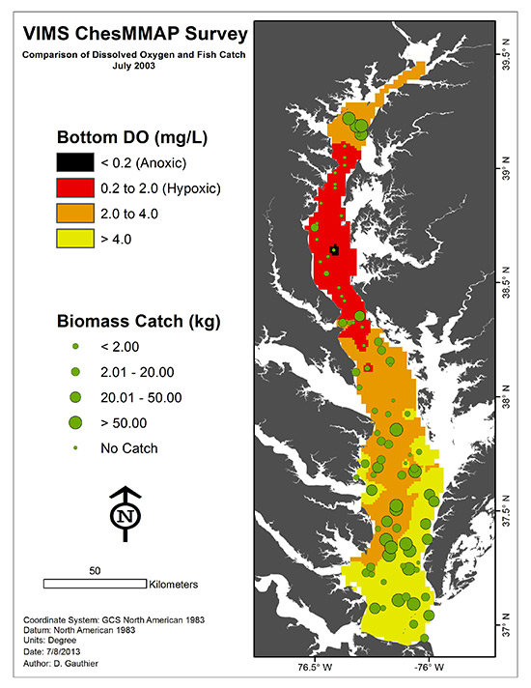
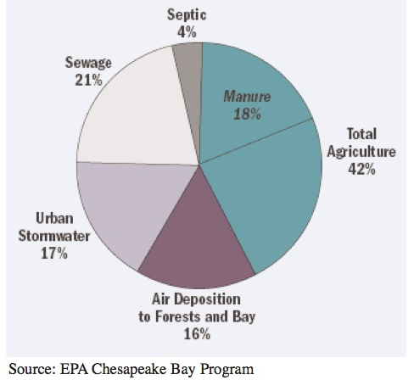
Impacts on Fishery and Nutrient Management
Understanding the drivers of hypoxia variability is critical for integrated ecosystem assessment, ecosystem projection and nutrient input management.
Notes:
Spatial patterns and gold on nutrient

Slide 44
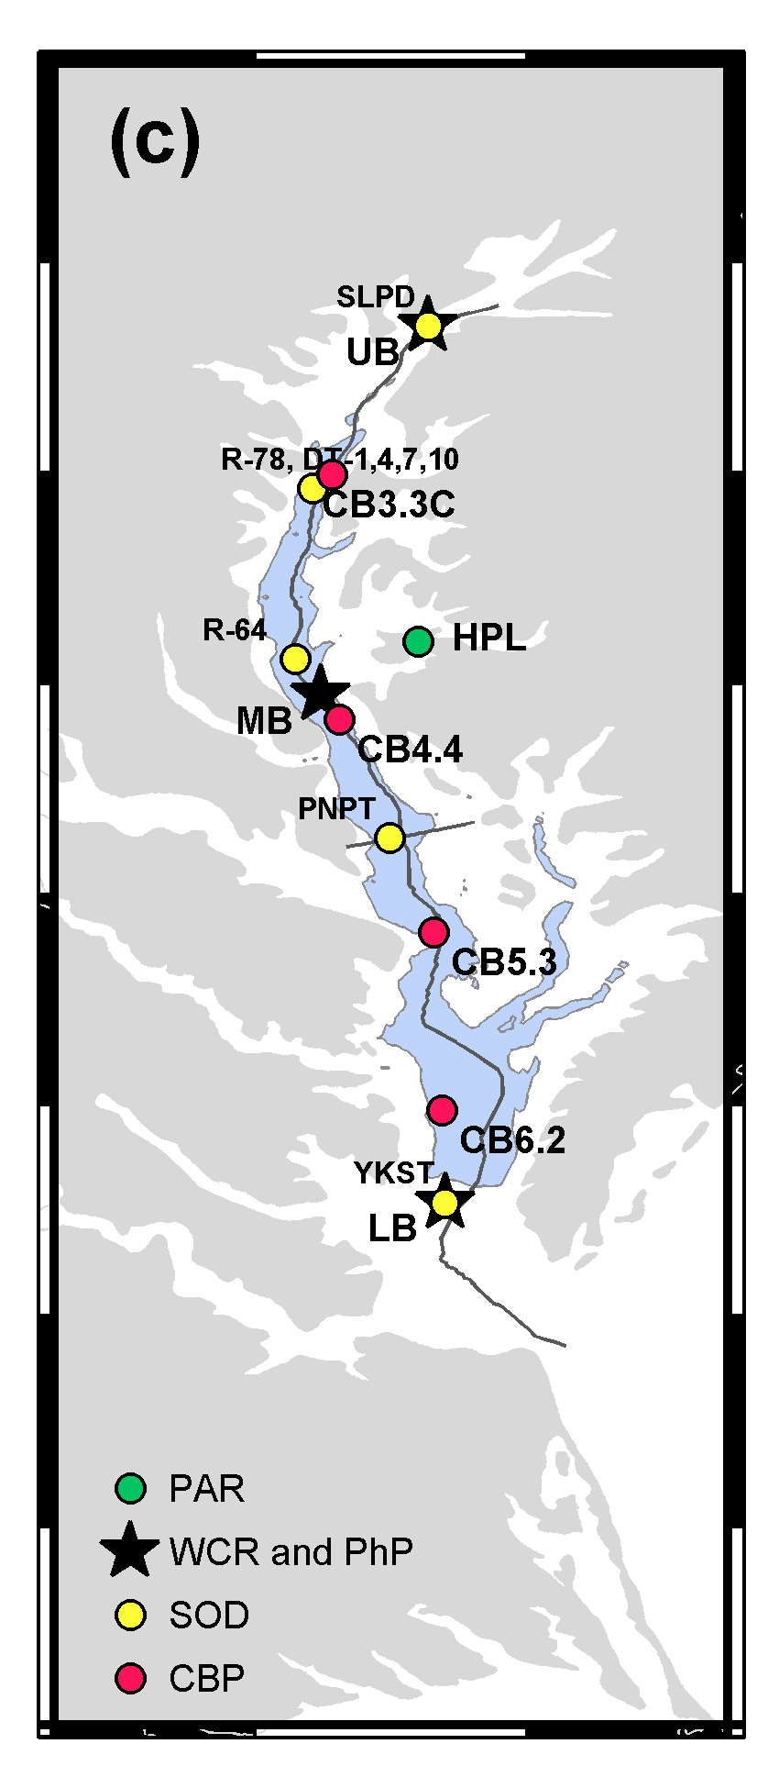

Model-Data Comparison
Reasonable match of seasonal cycle
Different timing and duration

Slide 45

Model-Data Comparison
Match in spatial pattern
Hypoxia in the deeper portion of the bay.
Seasonal advance downstream and retreat upstream
Notes:
It occupies 28% of the total volume in the main stem

