Slide 1


Results and Discussion of the Continuous Water Quality Monitoring Network in the Delaware Inland Bays
Andrew McGowan¹, Scott Andres², Zachary Garmoe¹
¹Delaware Center for the Inland Bays, ²UD Project WiCCED, DGS

Slide 2
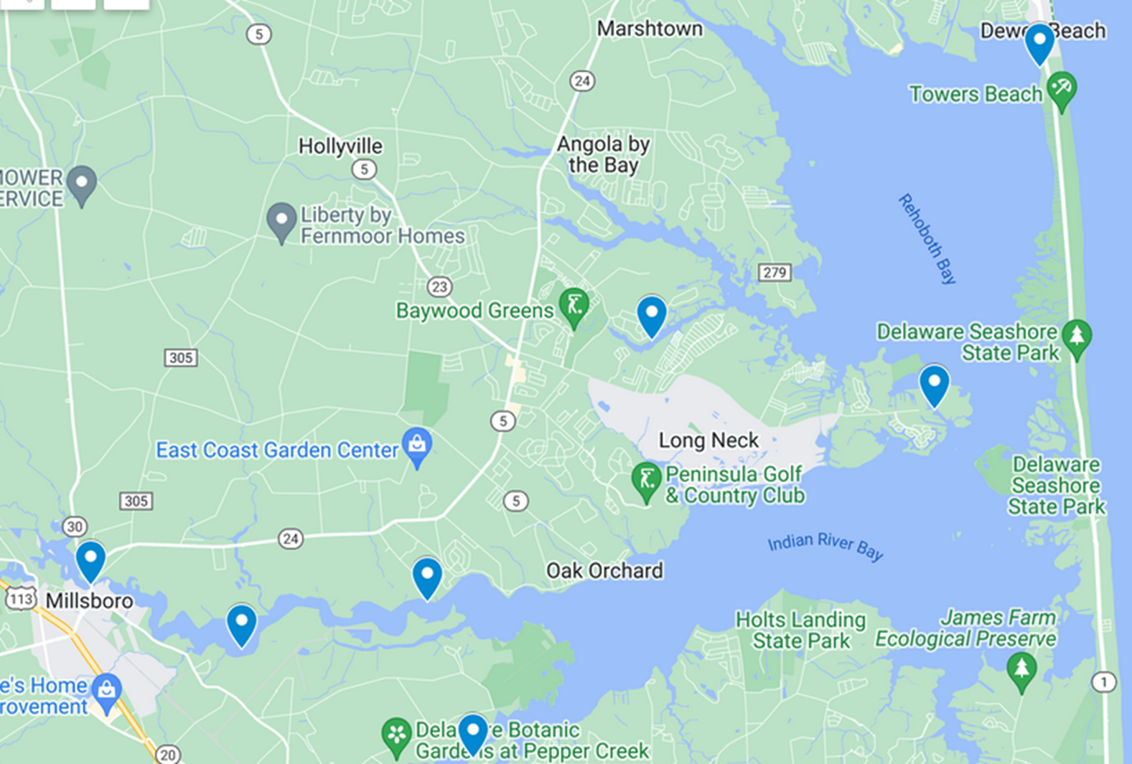
Notes:
Currently, the Center, in partnership with Project WiCCED, continuously monitors water quality at six locations. Three in Indian River, two in Rehoboth, and one in Little Assawoman. Not all of these stations have been up and running since 2020, but we’ve now acquired over 100,000 data records, and have plans for expansion. Why is this work important for the Inland Bays?

Slide 3
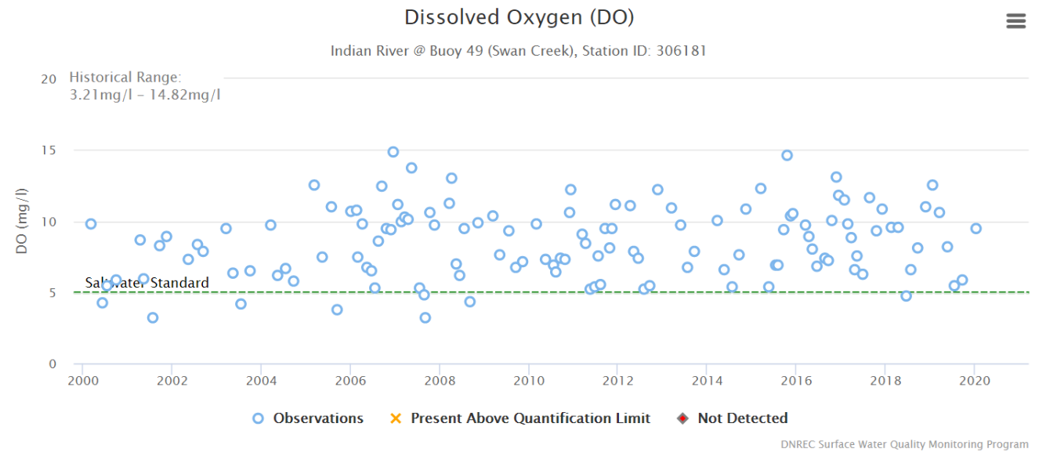
Notes:
Currently DNREC collects grab samples as part of their long-term monitoring effort. This is a plot of DNREC grab samples for Dissolved oxygen taken at Swan Creek in Indian River over time. The grab samples depict healthy conditions for aquatic life.
ANDREW - consider mentioning the DO values >10, especially summertime as supersaturated DO are evidence for large diel DO swings

Slide 4
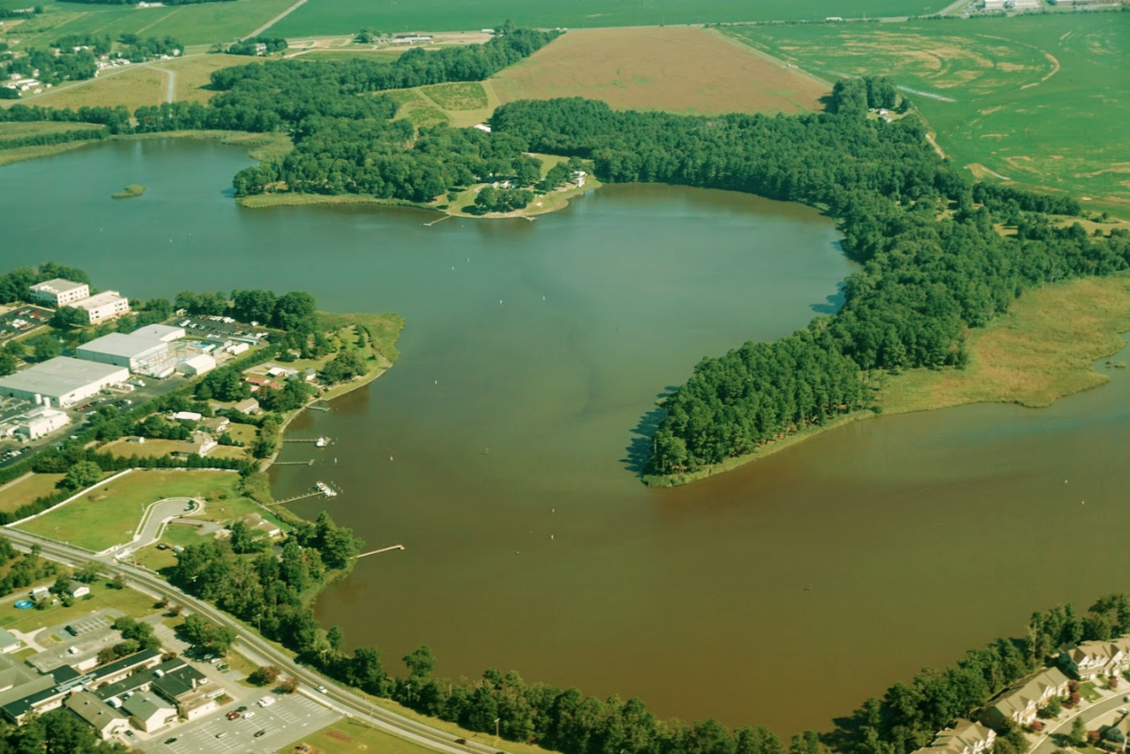
Notes:
However, we know that the upper indian river has annual large scale algae blooms, and sometimes frequent fish kills. So does it actually not have DO issues?

Slide 5
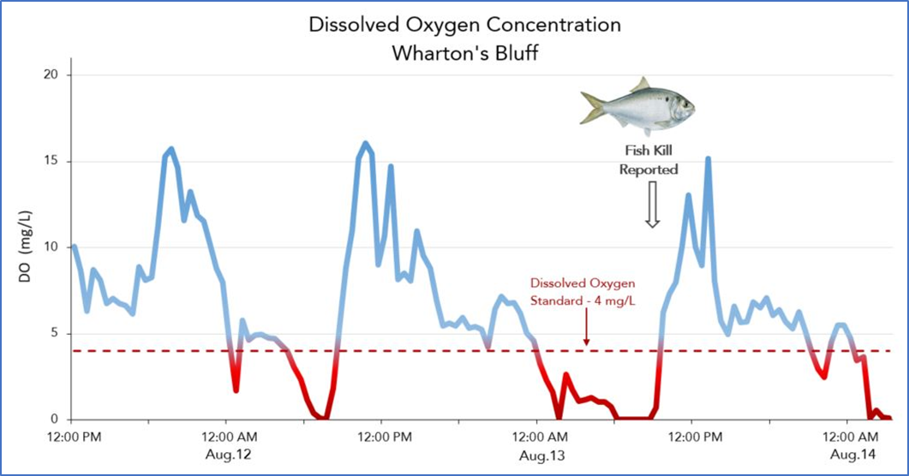
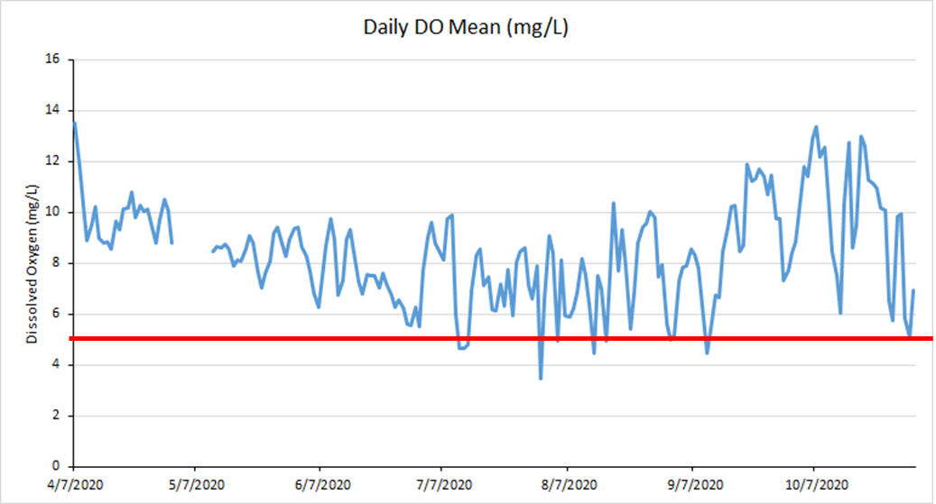
Notes:
Well, when we look at continuous data, we see the typical hypoxia pattern of low DO at night and early morning, and high DO during the day time. This hypoxia pattern suggest an unhealthy condition for aquatic life. That type of pattern is really only seen by looking at the full time series. Daily means of continuous data mask those patterns.

Slide 6
Changes in CWA Listing Status
Data was shared with DNREC from one site for the 2022 305(b) report
Resulted in the relisting of segment DE140-004
We’ll have data from at least six stations to share for 2024 report

Slide 7
Parameter | Regulatory Query Standards
Specific Conductivity | ± 3% of the standard value
Temperature | ± 0.2°C
Dissolved Oxygen | ± 0.3 mg/L
pH | ± 0.3 pH units
Turbidity | ± 5% of the standard value
Chlorophyll a | ± 10% of the standard value
Phycoerythrin | ± 10% of the standard value
Actual data and drift values are preserved
Standards (QA thresholds) can be retroactively tightened or loosened to meet the end-users needs
Notes:
So I want to transition to talking about how the network is performing, and what we’re seeing in 2021 and 2022. On the left is a table of the QA standards we require of our data in order to be sent to DNREC. These were based both on a similar program to ours, between NJDEP and Barnegat Bay Partnership, and also through discussions with DNREC at the time we started this work. We’ve since received EPA approval on our QAPP, which was another big accomplishment for us. The important thing to note is that the actual drift values are preserved, so the standards can be retroactively tightened or loosened depending on the end user’s needs.

Slide 8
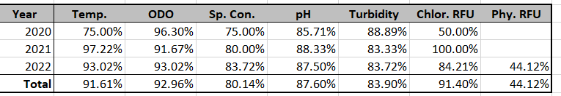
Percent of Deployments Meeting Regulatory Standard
Notes:
In a typical year we may deploy about 30 times for a given station, and we assess accuracy for each of those week long deployments. What we see is that over the last three years we’re consistently meeting the standards, over 80% of deployments ,sometimes 90% of deployments. These awesome QA results can be attributable to Zach who has done these weekly calibrations and cleanings for three years, and has developed a real nack for effectively deploying and maintaining these set ups.

Slide 9
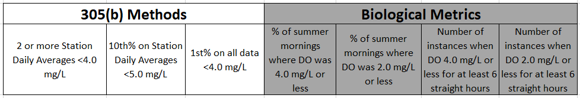
Assessment Methods
Notes:
Would be useful to briefly describe where the 305b method originated and what it is. It arises from USGS statistical procedures, and though numerically robust, it is only loosely associated with biological methods that evaluate organism response to environmental stresses.
Moving into actual measurement results, I’ll present the DO data from 2021 and separately for 2022. The 2022 season is still going, but the data presented here include April through August. Which encompasses our typical periods of interest. There are three ways the 305(b) report looks at aquatic life standards for DO.
Calculate daily averages for the monitoring period, no more than 1 of those averages may be below 4.0 mg/L
Calculate 10th percentile of these daily averages, then calculate the upper limit of 90% confidence interval for the 10th percentile, which must exceed 5.0 mg/L
Calculate 1st percentile of all observations (not daily averages), then calculate upper limit of 90% confidence interval for the 1st percentile which must exceed 4.0 mg/L
There are also four biological metrics we use to describe our continuous data.

Slide 10
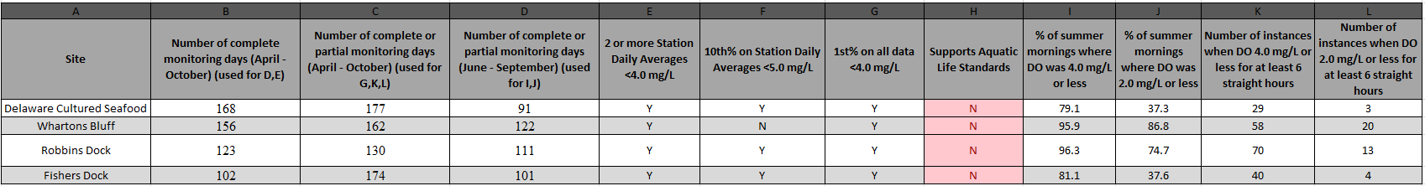
2021 DO Results
Notes:
In 2021 we measured two indian river sites, one pepper creek site, and one guinea creek site. We had pretty complete data records of over 100 full days with monitoring. There are lots of numbers up here but I’ll highlight a few that jumped out to me. The number of events where DO was less than 4 mg/L for at least 6 hours is amazing. At the best site, we still saw 29 different instances, at our worst, 70 occurrences. The number of hypoxic events is also poor. Wharton’s Bluff recorded 20 separate hypoxic periods that lasted at least six hours. Using those metrics I would say these waterbodies are impaired with regard to DO.
The good news is that the 305(b) analysis methods also produce a similar designation of “does Not support aquatic life” ((in line with what the biological metrics would suggest, which are that these waterbodies have unhealthy DO conditions. The small concern is that two of the 305(b) analyses revolve around the station daily averages, which in my opinion are not the best way to assess these continuous data. For example, the Wharton’s Bluff site had 20 major hypoxic instances, but the 10% of the station daily averages was above 5. Only one method is independent of the station daily averages, the 1st percentile of all available data.
These four stations are all in different assessment zones and will result in relisting. Delaware Cultured Seafood was delisted for DO in 2013, Whartons Bluff was recently relisted due to these data from last reporting period, Robbins Dock segment was delisted in 2018, and Fishers Dock segment was delisted in 2010.

Slide 11
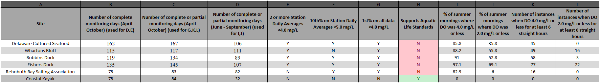
2022 DO Results
Notes:
In 2022 we added the Rehoboth Bay Sailing Association up near Tower Rd and Dewey Beach. That site was installed at the end of June. We also formally added an existing station in Little Assawoman Bay near Coastal Kayak that had been part of an oyster reef project. We wanted to keep that site in place because we felt like the long-term salinity data would be valuable for potential clam farmers since its near the approved SADAs.
This data only includes up through the middle of September since the season is still ongoing, and for Coastal Kayak, only through July. We missed an August reading and that sonde stays out much longer than the others. So we haven’t had the chance to update it yet.
As in 2021, we see major DO problems in the tributary sites. Most summer mornings failing the standard, and frequent hypoxic periods. Again, encouragingly, the 305(b) methods also returned a similar result to the biological metrics. I think especially encouraging is the similar result for Sailing Association which frequently fails the standard, but isn’t as prone to hypoxic periods as the other sites. It still shook out impaired in the 305(b) methods, which tells me the 305(b) methods might be adequately sensitive to picking up imparied areas which aren’t as terrible as these upper tributaries.
Once again though, the Wharton’s Bluff area shows the potential pitfall of relying on station daily averages, and the importance of the 1st percentile of all data available.
Coastal Kayak has much more limited data so far, but looks good thus far.
Between 2021 and 2022 we had a similar number of hypoxic periods less than 2 mg/L, and more periods less than 4 mg/L amongst the sites that were in both years. My next step is to work out some good ways of comparing years together, that are a little more explanatory or meaningful for aquatic life.

Slide 12
Causes of hypoxia in coastal lagoons
Non-linear response to multiple time-variant stresses
Decay of organic load - watershed, internal, or coastal ocean
Diel photosynthesis - respiration
Bottom sediment-water column reactions - can be inorganic or organic
Thermal - gas solubility
Notes:
Following is a first cut at assessing causes of hypoxia due to multiple inter-related processes. Much work remains.
In I.B. we know that the coastal ocean is not a significant source of low DO water and has much lower organic matter and nitrogen content than water in the bays and tributaries.
We know that bottom sediment are significant potential sources of oxygen demand due to biological and non-biological processes. (Cornwell et al)
No clear correlation between hypoxia and salinity and tides. Will not show results of these analyses.
Large temporal variability in turbidity and pigments masks relationships with DO.
Still researching appropriate methods for evaluating pigment data, but safe to say pigment concentrations are hundreds of times larger in growing season than non-growing.

Slide 13
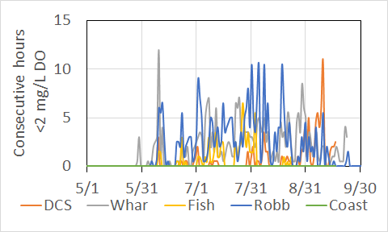
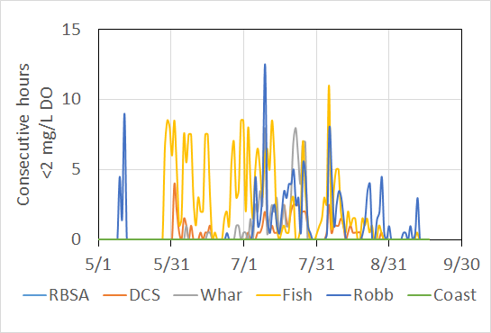
Hypoxia duration, frequency, and magnitude
2021
2022
Low DO events in 2022 longer and deeper than 2021.
Most DO events <4 had associated but shorter <2 event.
Notes:
Knowing gross statistics of low DO such as percentile values such as what is done for 305b is just one way of viewing DO conditions
We were looking for a metric that would be directly associated with biological/geochemical impacts of hypoxia such as fish kills, habitat degradation, and water-sediment reactions.
We hypothesize that duration, frequency and magnitude of low DO would better characterize the risks to aquatic life than a whole population metric.
Explain Y axis
Note differences between RBSA and Little Assawoman open water sites in comparison to tributary sites..

Slide 14
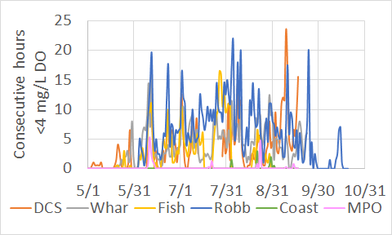
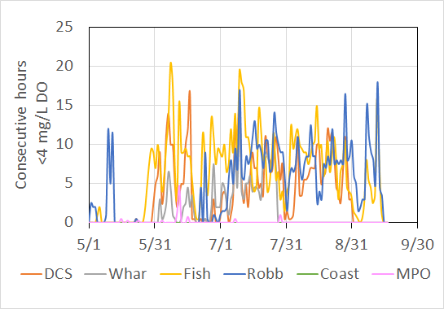
Load of low DO water from watershed?
2021
2022
MPO has low DO events but duration and magnitude are less than in estuary
Notes:
Does not appear that enough low DO water is delivered from watershed to cause low DO in the tidal tributaries.

Slide 15
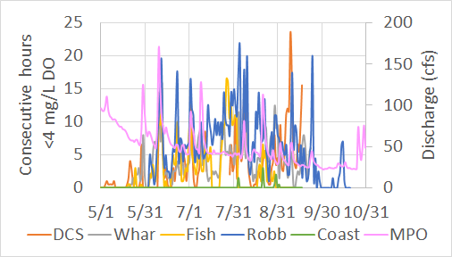
Storm runoff driven?
Clear association between storm
runoff events and low DO, but….
limited delivery of low DO water,
no time lag AND
low DO events occur without storm runoff.
Notes:
Explain y axes - hours and discharge
Does not appear that organic load from the watershed is sufficient to drive tributary hypoxia.
First because not every storm has a corresponding low DO effect
Second, there is no time lag. Time lag is expected because it takes time for system to process load of organic material.

Slide 16
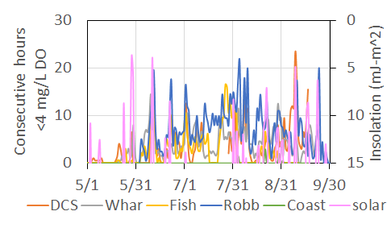
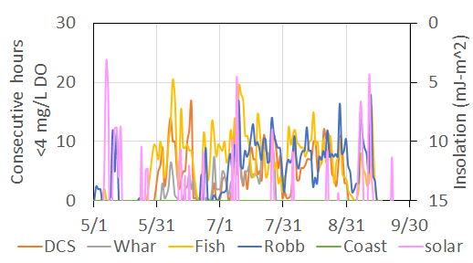
Insolation = solar energy ~ PAR
2021
2022
Most low DO events associated with cloudy days but not all. July both years and August 2022 have low DO events during sunny weather. Is there another trend?
Notes:
Plant growth is dependent on sunlight, so what is the association between low DO events and sunlight.
Insolation measured at Dagsboro DEOS station.
PAR is photosynthetically active radiation.
Note insolation axis is reversed so cloudy/rainy days are shown by upward spikes on the pink line

Slide 17
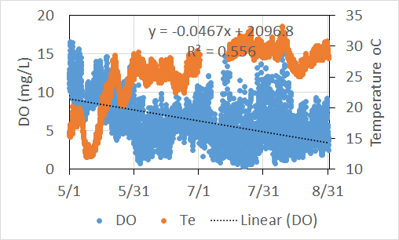
Temperature effect on DO
Decreasing DO over season is significant for occurrence of low DO events.
Interesting that temperature greater than about 9 degrees seems to signal onset of lower DO
Similar trends observed at other tributary stations over both years
Greatest diel DO swings occur in warmer water and longer daylight hours
(DCS site)
Notes:
Clear temperature association with hypoxia. Not a new idea but having direct data makes a stronger argument than theorizing.
It appears that DO conditions at our tributary stations are mostly unsuitable for aquatic animals for months every year. To me this is a loss of habitat.
Thinking ahead, is it appropriate to use a full year’s data to characterize DO conditions when problems are mostly occurring in the summer?
Similarly, is it appropriate to consider the long periods of supersaturated DO during summer towards DO statistics? For example DO saturation values greater than 200% are routine and long daylight hours > 13 hours for a couple months can bias DO statisitcs.

Slide 18
Summary
Multiple variables, time variant stressors and processes, internal feedback loops….
This type of system is what coupled hydrodynamic - water quality simulators were built for.

Slide 19
Considerations and STAC Input on Methodologies
  Pretty happy with how 305(b) methods reflect biological metrics. See in future years at “medium” imparied sites how the methods compare.
  Consider incorporating some type of temporal restrictions on 305(b) methods e.g., 1st percentile of all data. Monitoring period from April through October, upper confidence interval value changes when data are collected year round from a station, compared to summer only.
    Work towards establishing biologically and geochemically important thresholds. What values of hypoxia duration, magnitude (below what value), frequency too large cause adverse impacts on organisms and other water quality indicators?
    Open for ideas, future projects, references from other systems
Notes:
We’ve got a lot of data saying the DO fails the standards, and also remains hypoxic for long periods.
But how do crabs and flounder respond to low DO? In the absence of frequent fish kills do they leave for better water, are they not impacted, or something in between?
From work in the region we know that low DO events can cause bottom sediment to release more P, ammonium, or hydrogen sulfide and can inhibit nitrification and denitrification. Should high pH values associated with large diel DO variations be another metric to be evaluated?
Need to work on acquiring more frequently collected data on N and P along with the DO, pH, etc from the existing network.

Slide 20
Considerations and STAC Input on Future Locations
Increase from 6 to 9 stations in 2023
Love Creek and Whites Creek
9th station undecided
Open to suggestions that are beneficial to the group here or researcher labs you’re aware of

