Slide 1

Developing Oyster Nutrient Trading in Maryland: Will it ever payoff?
Suzanne Bricker
NCCOS Leader for Ecosystem Services
NOAA
Matt Parker, PhD
Aquaculture Business Specialist
University of Maryland Extension
Notes:
1
1
1

Slide 2

Process to establish a Best Management Practice
Petition EPA for permission to form a panel to look at the topic
Submit potential panel members to EPA for approval
Regular panel meetings
Research information
Obtain group consensus
Write report(s) of findings
Present report publicly
Address public comments
Resubmit report
Appropriate agency members approve/disapprove
BMP is then created only for items in the report
Up to municipalities to determine any potential compensation system.
Notes:
the interesting thing about the CHes Bay oyster panel is that the growers applied pressure to have a review made..... when you talk about this point maybe emphasize that the growers HAVE to be involved, they should be leading the pressure to make the panel and the review as was done in Ches
there should be a lead recognized also.... not sure how they would do that, ORP was sort of the perfect place to have the lead selected from and also local Uni (i.e. Cornwell)
only for items that are supported by the lit review and research... remember that shell is considered in the report but will not be credited.

Slide 3
Establishment of Oyster BMP for Chesapeake Bay
Oyster Recovery Partnership recommends Expert Panel formation to EPA (April 2015).
First panel meeting –Sept 2015
Projected Panel End Date (Aug 2016)
……But things took (much) longer than expected.
Panel Charges
Identify and define oyster practices for BMP consideration
Develop a pollutant removal crediting decision framework for oyster BMPs
Propose nitrogen and phosphorus removal effectiveness estimates for oyster practices determined to have sufficient science support

Slide 4
Panel Activities
Our panel ended up having about 16 members.
The goal was to reach consensus
That took a while.
Literature review for available science
Examined all papers to extract information
Reports and unpublished data
Evaluated information for appropriateness
Discussed nearly every paper
Independent Expert Panel Analysis of data.

Slide 5
Why did it take so long?

Slide 7
Tissue from Aquaculture-Low Hanging Fruit
Looked at all studies available for oysters from Chesapeake Bay.
  Included published and unpublished research data
Triploid & diploid oysters
Plotted values based on oyster size
Quantile regression to minimize over crediting

Slide 8
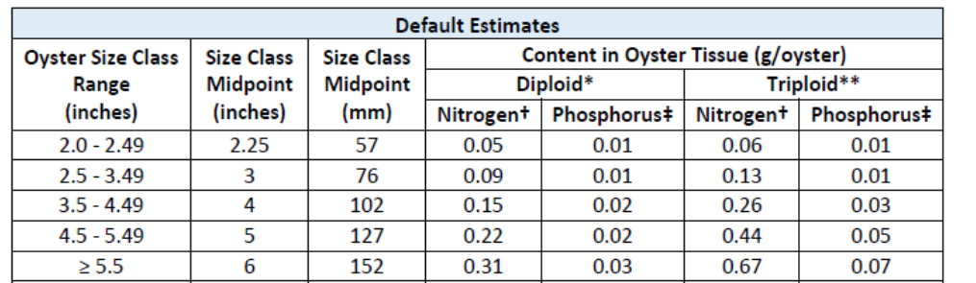
Panel Recommendations Approved
First report submitted Sept 2016
Approved Dec 2016
Included recommendations for N and P removal via aquaculture oyster tissue
Report delivered by estimated deadline, but 86 “scenarios” left to consider.
https://www.chesapeakebay.net/documents/Oyster_BMP_1st_Report_Final_Approved_2016-12-19.pdf
Notes:
do you mention here the public review etc? it is on an earlier slide but might be good to say again... and that the recommendation and report are then given to the WQGIT who has to vote to approve

Slide 9
Default Estimates for N and P Assimilated in Oyster Tissue
(Summarized for TMDL Application from Panel’s Findings)
BMP Name | Size Class Inches | Lbs N Reduced/ 1 Million Oysters Harvested | Lbs P Reduced/ 1 Million Oysters Harvested
Diploid Oyster Aquaculture 2.25 Inches | 2.0 – 2.49 | 110 | 22
Diploid Oyster Aquaculture 3.0 Inches | 2.5 – 3.49 | 198 | 22
Diploid Oyster Aquaculture 4.0 Inches | 3.5 – 4.49 | 331 | 44
Diploid Oyster Aquaculture 5.0 Inches | 4.5 – 5.49 | 485 | 44
Diploid Oyster Aquaculture ≥ 5.5 Inches | ≥ 5.5* | 683 | 66
Triploid Oyster Aquaculture 2.25 Inches | 2.0 – 2.49 | 132 | 22
Triploid Oyster Aquaculture 3.0 Inches | 2.5 – 3.49 | 287 | 22
Triploid Oyster Aquaculture 4.0 Inches | 3.5 – 4.49 | 573 | 66
Triploid Oyster Aquaculture 5.0 Inches | 4.5 – 5.49 | 970 | 110
Triploid Oyster Aquaculture ≥ 5.5 Inches | ≥ 5.5* | 1,477 | 154
Site-Specific Monitored Oyster Aquaculture | NA | NA | NA
*Midpoint based on 5.5 – 6.49 range
1 pound (Lbs) ~ 0.45 kg
Above BMPs would be reported annually and are only eligible in tidal waters (to qualify oysters had to be < 2 inches when planted and alive when removed)
Notes:
Grams of N and P in dry tissue/oyster for each size class was converted to lbs and multiplied by 1 million oysters to produce the BMP reduction credits for these practices.
Mention that the last BMP Name, “Site-Specific Monitored Oyster Aquaculture” is in reference to the Panel’s recommended methodology to determine site-specific estimates.
CBP modeling team are currently running scoping scenarios for aquaculture BMPs. Preliminary results show that increase in oyster aquaculture can have a significant impact on improving water quality at local embayment scales (mention that the CB TMDL is comprised of many TMDLs)
Also, the reduction effectiveness shown here is just for two protocols. Which leads me to my next slide….

Slide 10

Since Dec 2016
Panel has been evaluating the other scenarios
  N & P in shell
  Denitrification rates
  Sedimentation
  Public Fishery
  Restoration activities
Oyster Recovery Partnership is currently writing second report for Expert Panel review. 2nd report will focus on denitrification
https://www.pngitem.com/middle/iiwwmxR_homero-simpson-png-transparent-png/
Notes:
might mention again here that though being considered, shell will
if you have time and want to get into the detail, you could talk about the removal of nutrients from active uptake by phytoplankton thus 'removing from the water' but not fitting the legal definition of having to be physically removed from the water via harvest.... and that an EPA law review approved the crediting of restored reefs sequestration into tissue and shell.... and will also approve (hopefully) the related denitrification based removal not be credited since we want shell to go back in to grow more oysters :-)

Slide 11
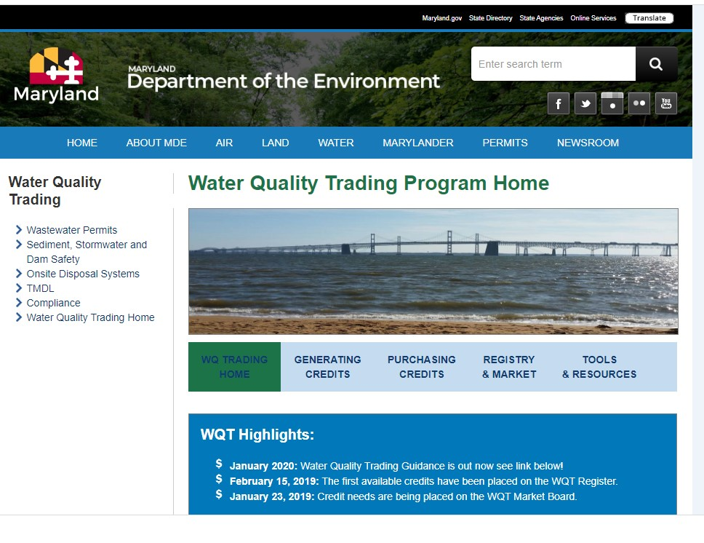
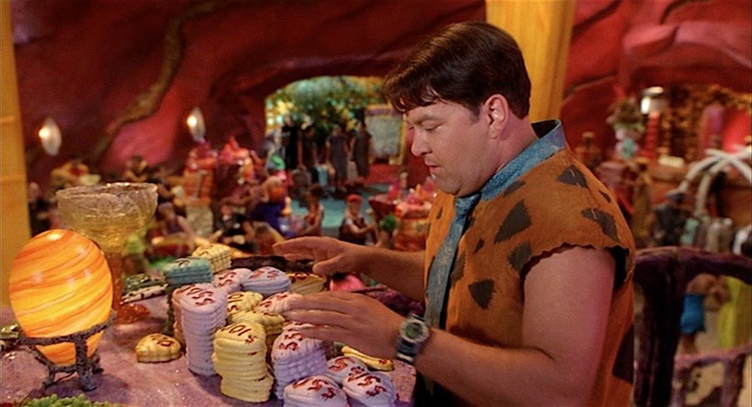
What about compensation for credits?
Expert panel only determines nutrient reduction rates
Individual municipalities (state, county, city, etc.) determine IF and HOW compensation will be implemented.
https://mde.maryland.gov/programs/Water/WQT/Pages/index.aspx
https://dygtyjqp7pi0m.cloudfront.net/i/24025/24263044_5.jpg?v=8D34287A0B0C750

Slide 12

Shellfish Trades to date…..
Voluntary market
Baltimore Convention Center purchased 4 Nitrogen credits in May 2020 for $1600
Regulatory Market
Anne Arundel County purchased 107 lbs Nitrogen and 12 lbs Phosphorus in June 2020 for $4,950 to offset runoff from impervious surface.
https://spongebob.fandom.com/wiki/Mr._Krabs%27_one_millionth_dollar

Slide 13
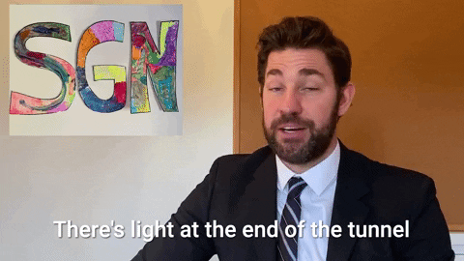
Potential purchases?!?!
Maryland Dept of Environment
  Clean Water Commerce Account For Environmental Outcomes
  Deadline was Sept 9, 2022
  MDE provides $7 million per year to purchase N credits from agriculture for 10-20 years

Slide 14
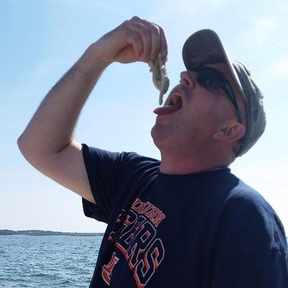
Questions
Dr. Matt Parker
Aquaculture Business Specialist
University of Maryland Extension
Prince George’s County Office
6707 Groveton Drive
Clinton, MD 20735
mparke11@umd.edu
301-868-8780 ext 428
(301) 599-6714 (fax)
http://extension.umd.edu/aquaculture

