Slide 1
Modeling and Monitoring Issues in the
San Francisco Bay-Delta
John Callaway
University of San Francisco &
Past Delta Lead Scientist

Slide 2
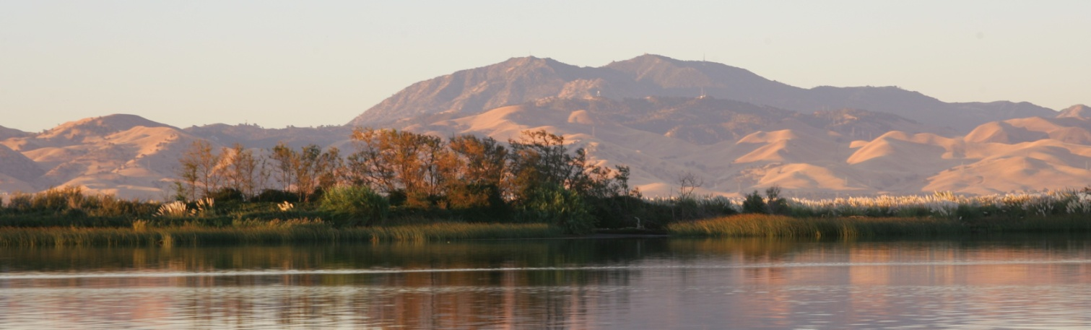
Overview
San Francisco Bay and the Sacramento-San Joaquin Delta: one big estuary!
Modeling issues across the estuary and beyond
Monitoring efforts in the Bay and Delta
GOAL: introduce you to programs from the San Francisco Estuary that might be informative for you

Slide 3
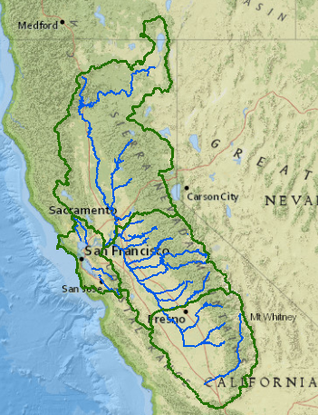
San Francisco Bay and Sacramento –San Joaquin Delta
Largest estuary on the West coast of the U.S.
Very different than East coast and Gulf coast estuaries

Slide 4
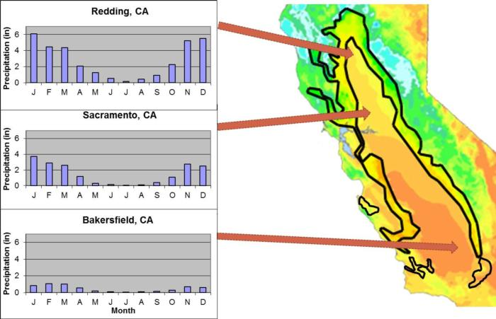
Mediterranean Climate:
Arid and Very Dry Summers
(from http://rangelandarchive.ucdavis.edu/)

Slide 5
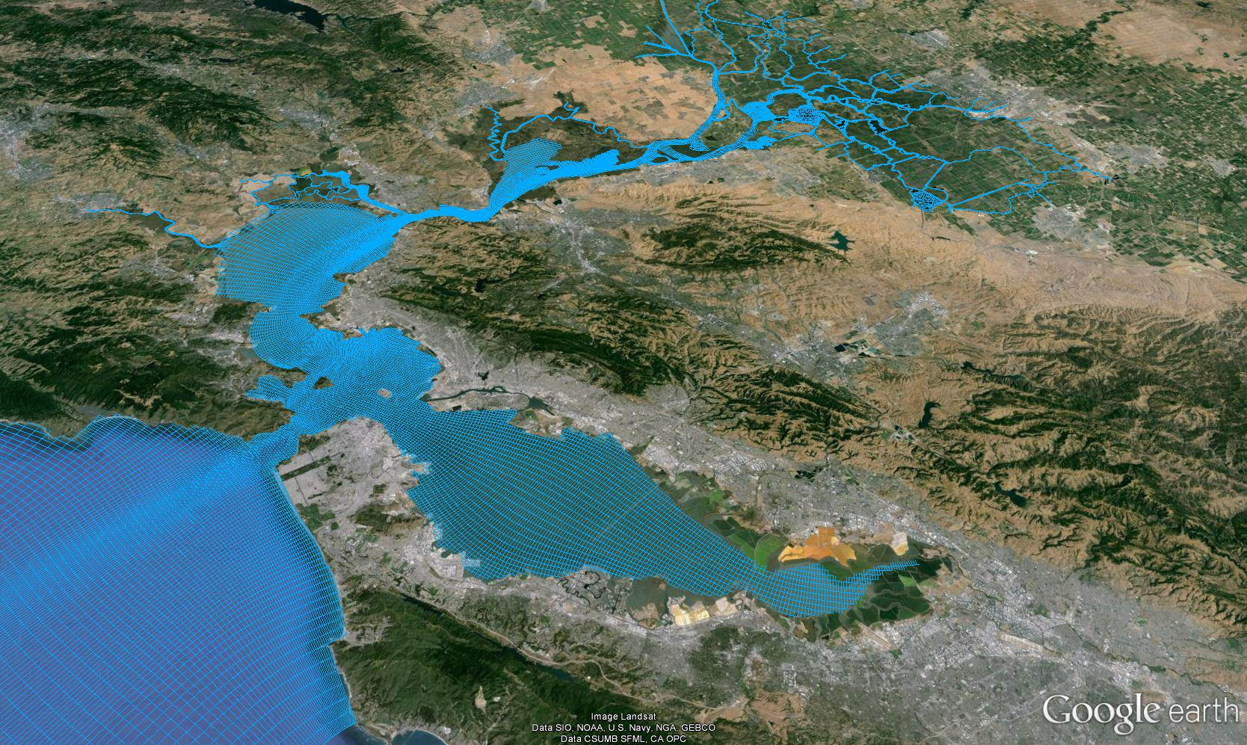
Bay and Delta are Semi-Isolated: Inland Delta
Image from http://www.d3d-baydelta.org/

Slide 6
Large Scale Impacts to the Estuary
~90% loss of wetlands
Substantial reduction in freshwater flows to the estuary
Invasive species are major issue
Water quality: improving in many aspects, but contaminants continue to be a problem

Slide 7
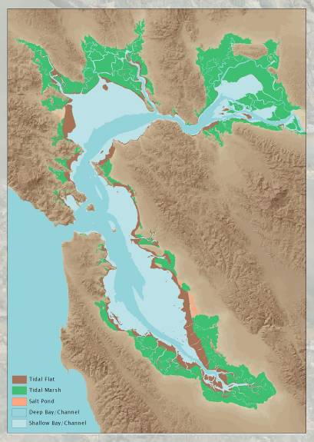
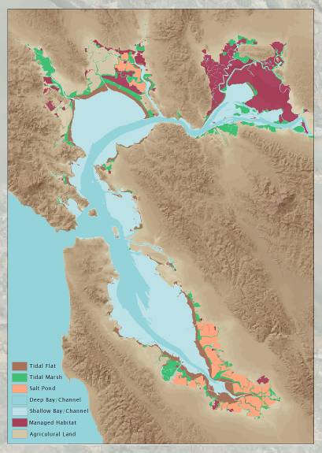
Past and Present Distribution of SF Bay Wetlands
(from San Francisco Estuary Institute)

Slide 8
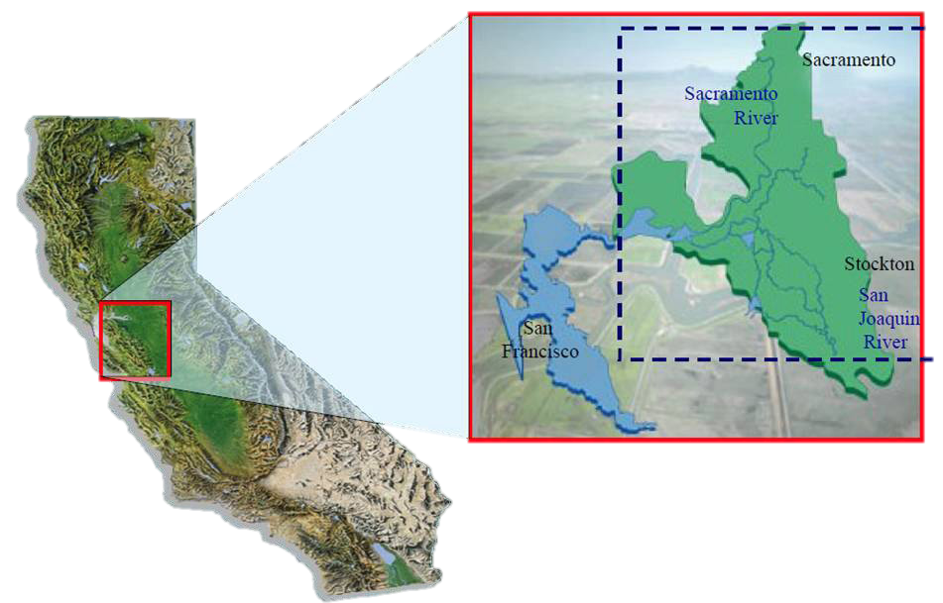
Sacramento-San Joaquin Delta
The Delta – Heart of the World’s Largest Water Supply System

Slide 9
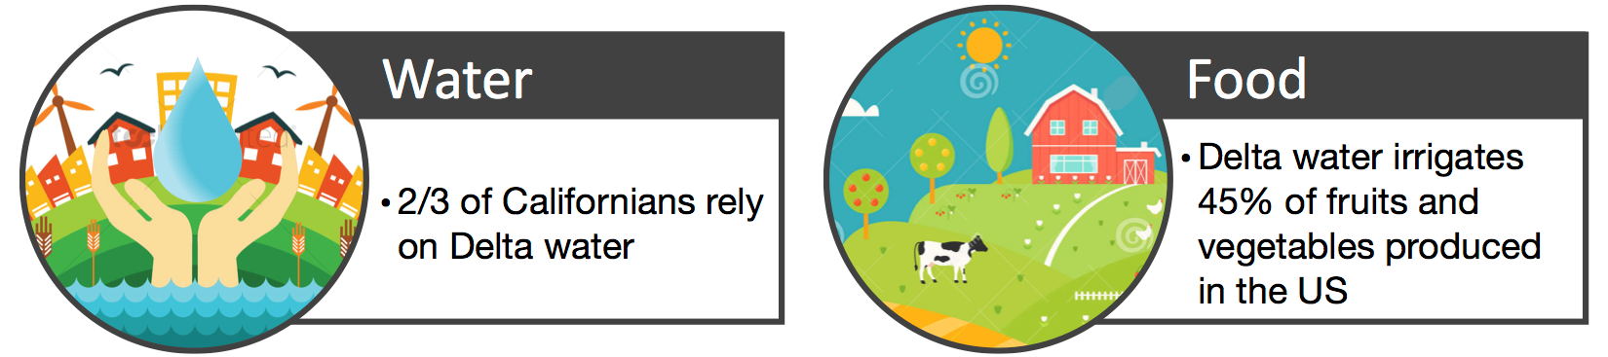
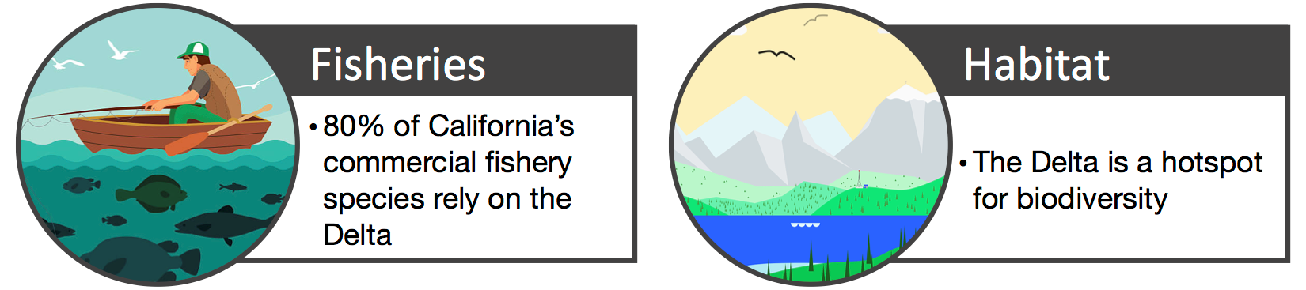
Importance of the Delta

Slide 10
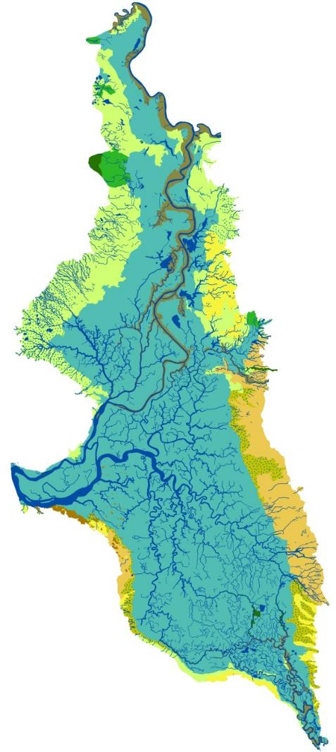
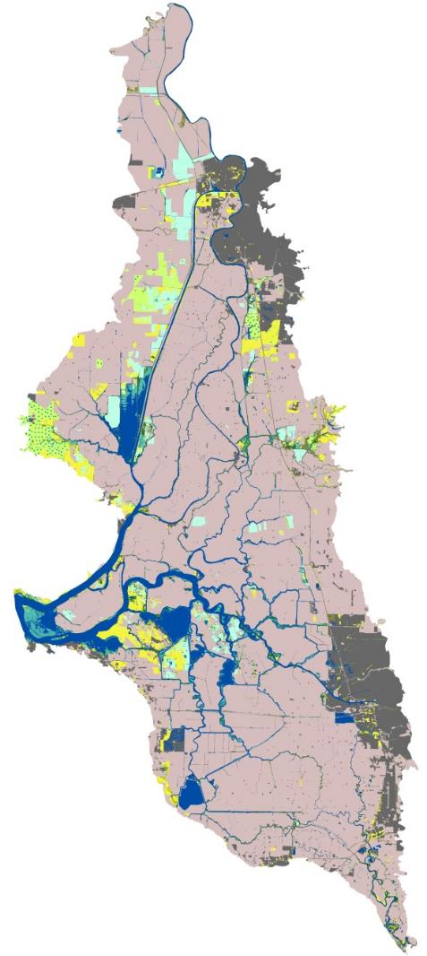
Loss of Wetland and Floodplain Habitat
in the Sacramento-San Joaquin Delta
~75% loss of primary productivity in the Delta
Little remaining habitat for native estuarine and riverine species
historical
modern
(from Delta Renewed, SFEI-ASC, 2016)

Slide 11

The Delta Stewardship Council &
Delta Science Program
Coequal goals:
  Provide long-term reliable water supply for the state
  Protect and restore Delta ecosystems
  Protect the Delta as an evolving place
Delta Science Program & Mission:
  Provide the best possible, unbiased scientific information for water and environmental decision-making in the Delta
  “Honest broker” for contentious science
  https://deltacouncil.ca.gov/

Slide 12
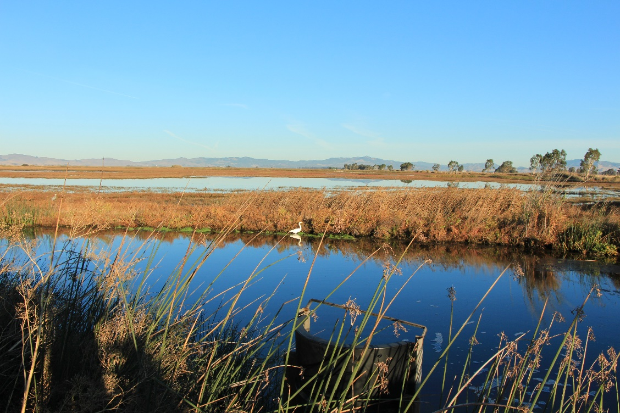
Modeling in the SF Estuary and More
Delta modeling
South SF Bay Salt Pond Restoration Project (not modeling, but very good restoration framework)
Louisiana Coastal Master Plan

Slide 13
Modeling in the Sacramento Delta
Hydrological modeling is very well developed: multiple models are available
Focus has been primarily on water management in the Delta
2020 Report includes inventory and review of Delta models: https://cwemfwiki.atlassian.net/wiki/spaces/MI/overview

Slide 14

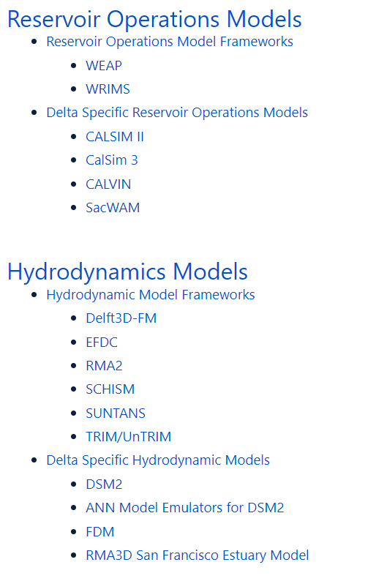
Modeling in the Sacramento Delta
from recent inventory (see web link on previous slide)

Slide 15
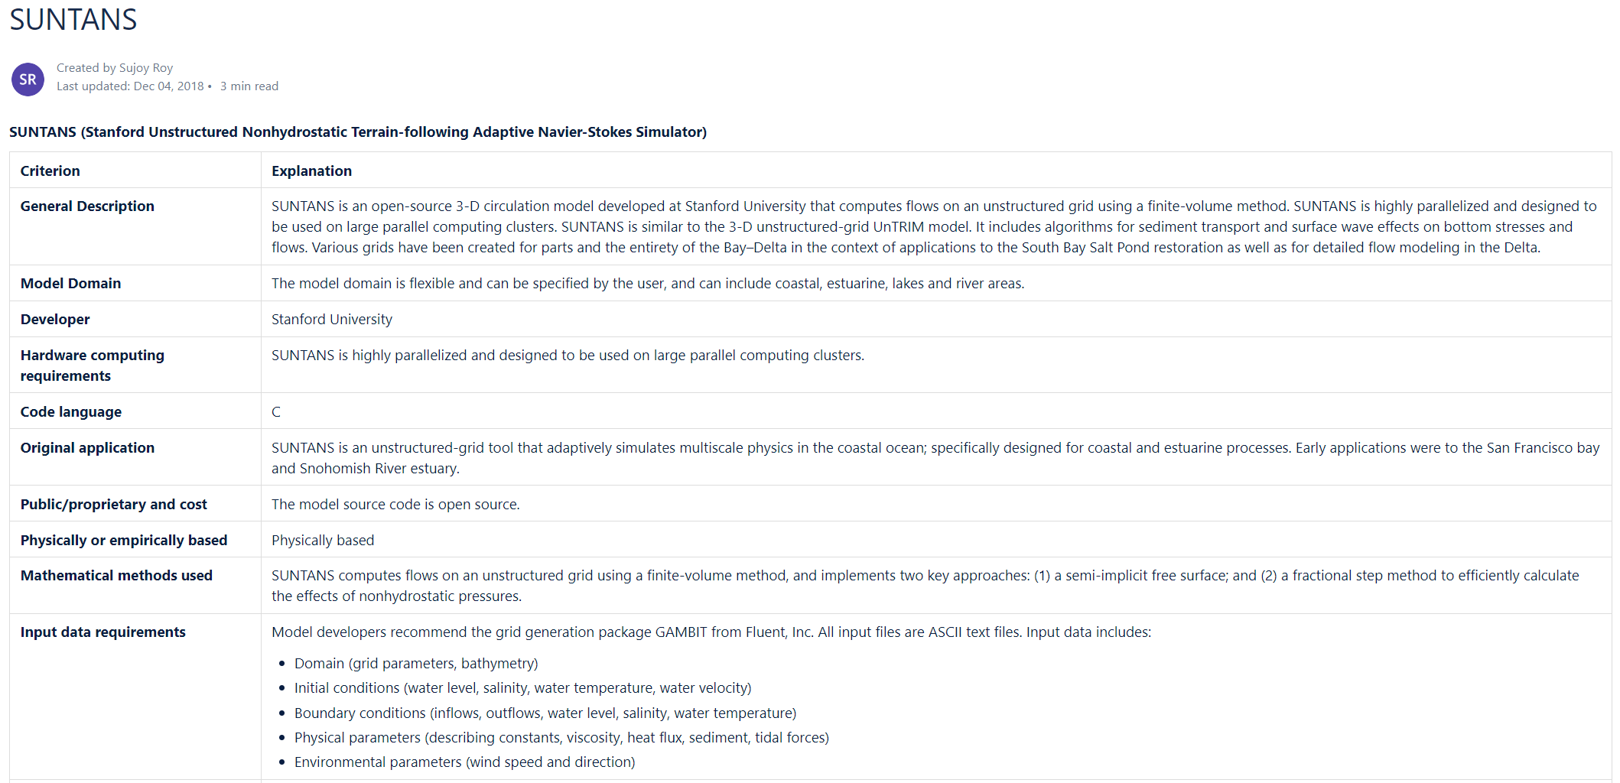
Modeling in the Sacramento Delta

Slide 16
Modeling in the Sacramento Delta
On-going effort to INTEGRATE physical and biological models (plus Bay and Delta modeling)
Chesapeake Bay and other systems used as a model
2020 Review of modeling efforts in the Delta. Available at: https://deltacouncil.ca.gov/delta-science-program/integrated-modeling-steering-committee

Slide 17
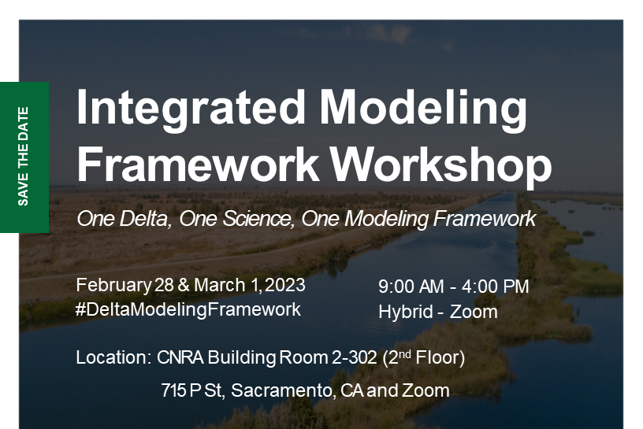
For info email: hello@deltacouncil.ca.gov

Slide 18
South Bay Salt Pond Restoration Project
Habitat loss
Highly urbanized
Lots of public support for restoration
Salt Ponds are the major opportunity for Bay restoration: LARGE-SCALE increase in wetland habitats
Lots of interest in climate change resilience
Of course, many challenges/uncertainties…

Slide 19
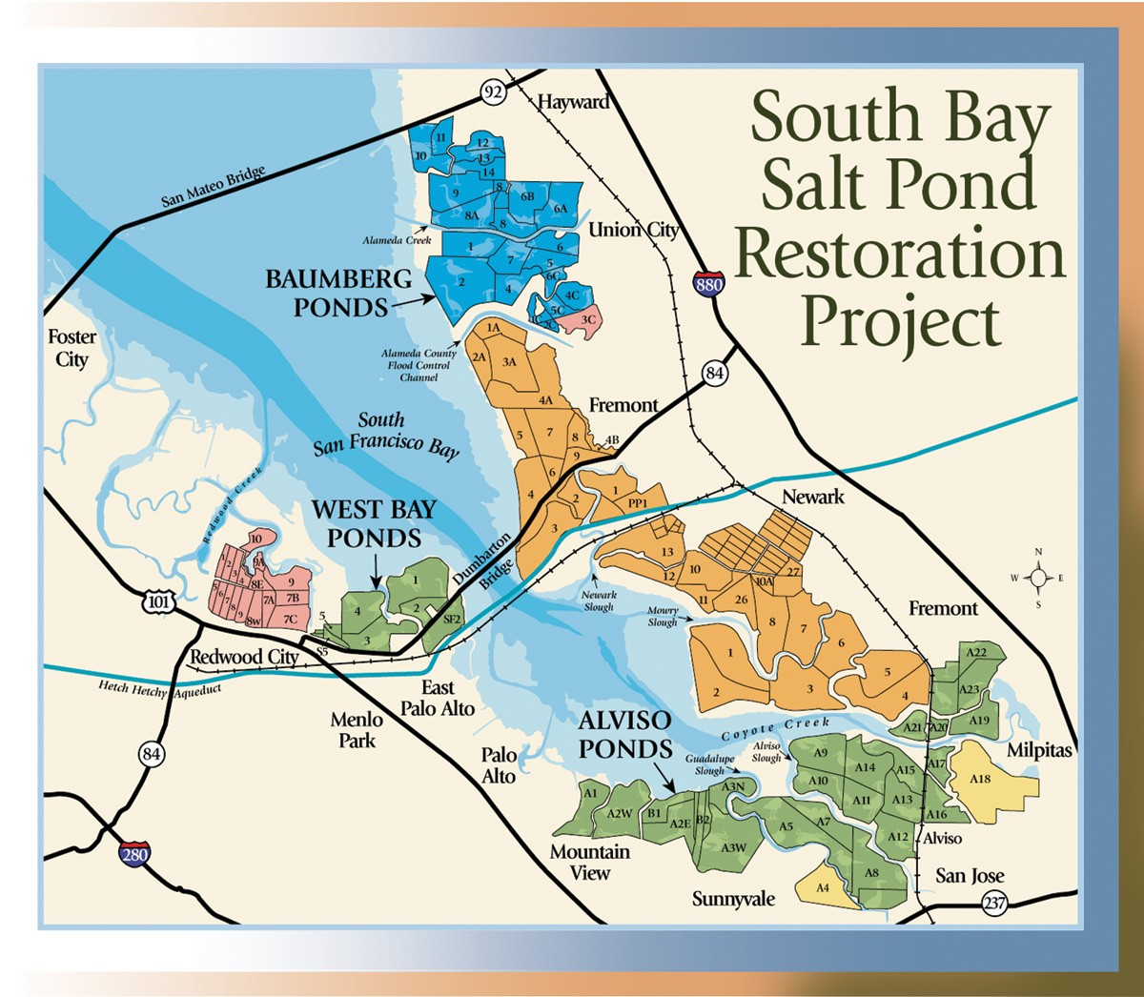

Slide 20
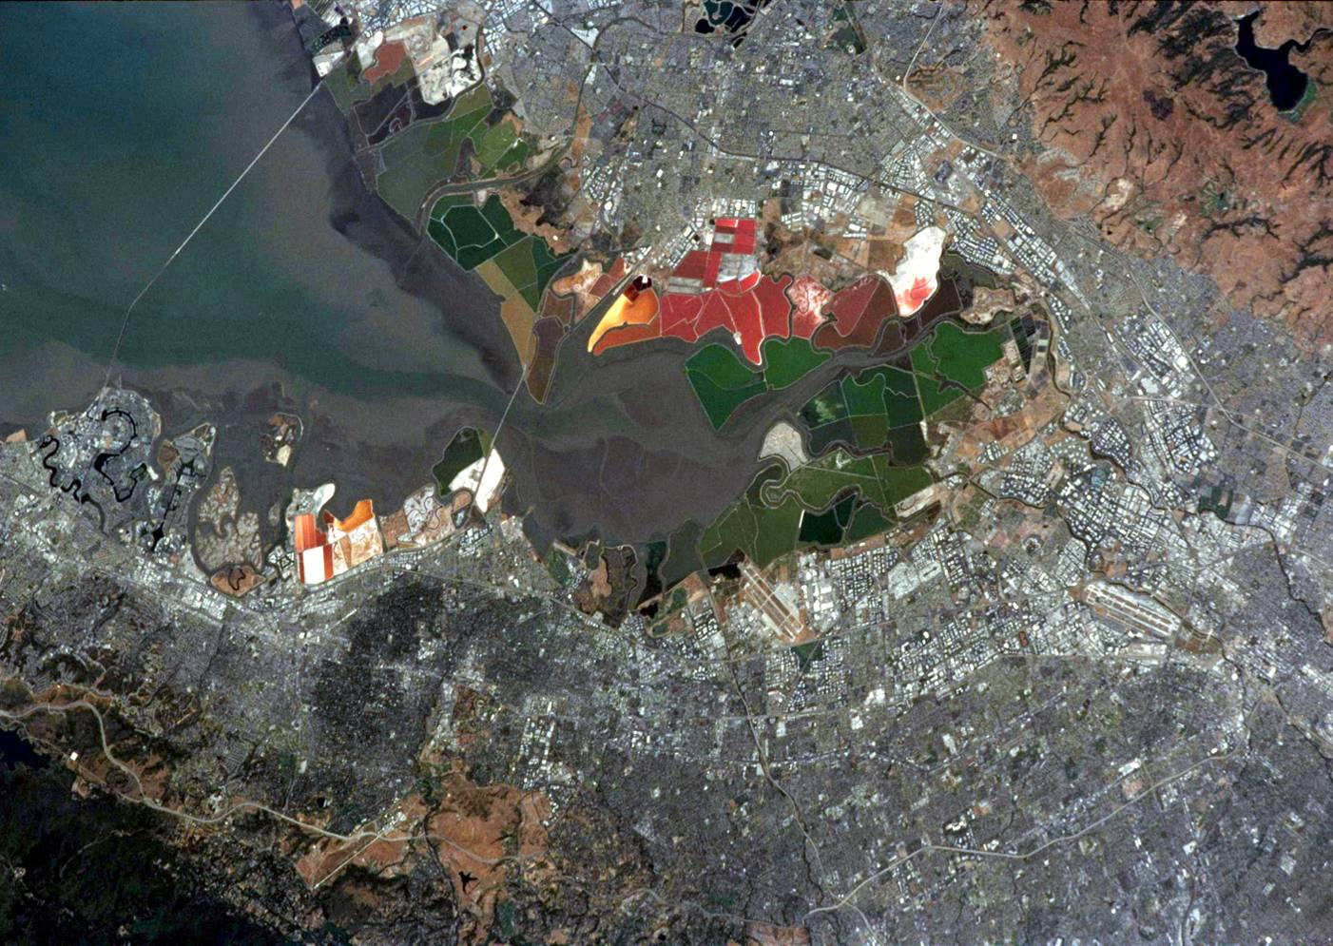

Slide 22
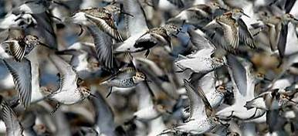
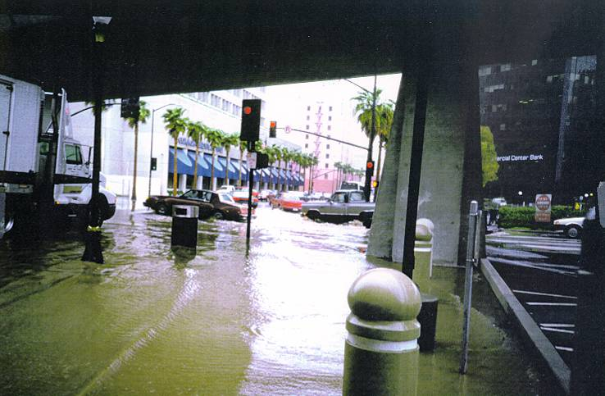
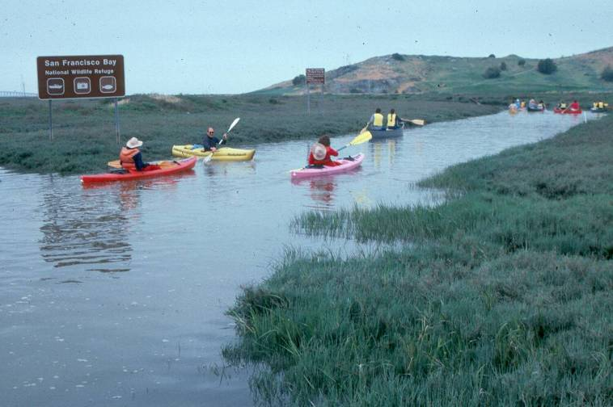
Long-term Restoration Goals
A mix of habitats
Flood management
Wildlife-oriented recreation

Slide 23
Major Uncertainties for Salt Pond Restoration
Appropriate mix of habitats (managed ponds, tidal marsh, and mudflats)
Mercury contamination & biogeochemistry
Sediment availability
Invasive / problematic species
Flooding risks

Slide 24
Approach to these Uncertainties
Phased restoration
Adaptive management
Series of experiments and management actions to evaluate key uncertainties
Working with the US Army Corps of Engineers to evaluate flooding risk
https://www.southbayrestoration.org/

Slide 25
Louisiana Coastal Master Plan
Large-scale integrated model to evaluate restoration opportunities in Louisiana
Long-term effort: started over 10 years ago (and really way before this…). First Master Plan was adopted in 2012.
Newest draft Plan just came out in January 2023: https://coastal.la.gov/our-plan/2023-coastal-master-plan/

Slide 27
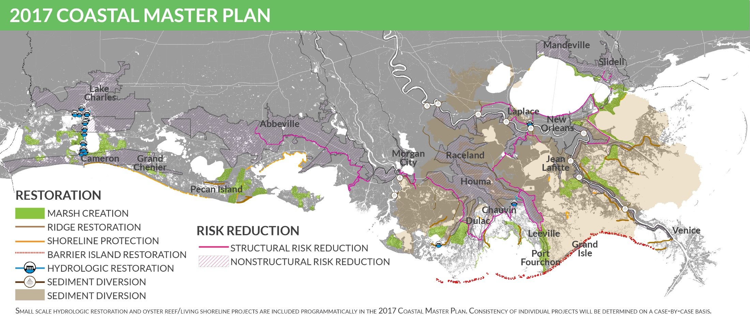

Slide 28
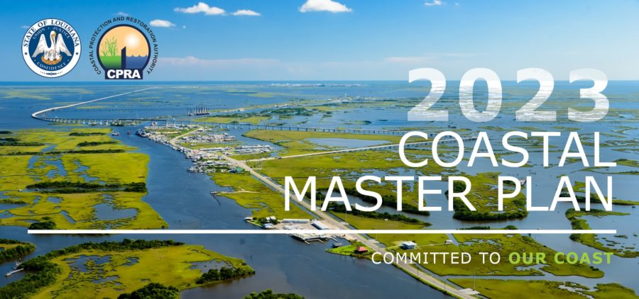
Louisiana Coastal Master Plan
https://coastal.la.gov/our-plan/2023-coastal-master-plan/

Slide 29
Monitoring in the SF Estuary
Interagency Ecological Program (IEP): Delta
Regional Monitoring Program (RMP) Bay water quality
Wetlands Regional Monitoring Program (WRMP): Bay wetlands

Slide 30
As with Modeling: Bay and Delta Monitoring
Efforts are Relatively Isolated

Slide 31
Interagency Ecological Program
Initiated in 1970 to evaluate impacts of water projects in the Delta
Nine state and federal agencies
Monitoring completed by agency staff with some university collaboration
https://iep.ca.gov/

Slide 34
Interagency Ecological Program
Large-scale effort, with many critics (but IEP is an easy target)
2019 review of IEP framework and 2022 review of overall monitoring by Delta Independent Science Board:
https://deltacouncil.ca.gov/delta-isb/products

Slide 35
Adaptive Management
Monitoring Framework
from Delta Independent Science Board Monitoring Review

Slide 36
Regional Monitoring Program
Initiated in 1993
Focus on water quality monitoring
Funded by permitted dischargers in the SF Bay
GOAL: Collect data and communicate information about water quality in SF Bay in support of management decisions
https://www.sfei.org/rmp

Slide 37
Regional Monitoring Program
https://www.sfei.org/programs/pulse-bay

Slide 38
Regional Monitoring Program
from RMP 2021 Multi-Year Plan

Slide 39
Wetlands Regional Monitoring Program
Initiated in 2019
Funded by EPA and local Restoration Authority
Currently establishing network of sites (benchmark, reference, & project), monitoring protocols, and more
https://www.wrmp.org/

Slide 40
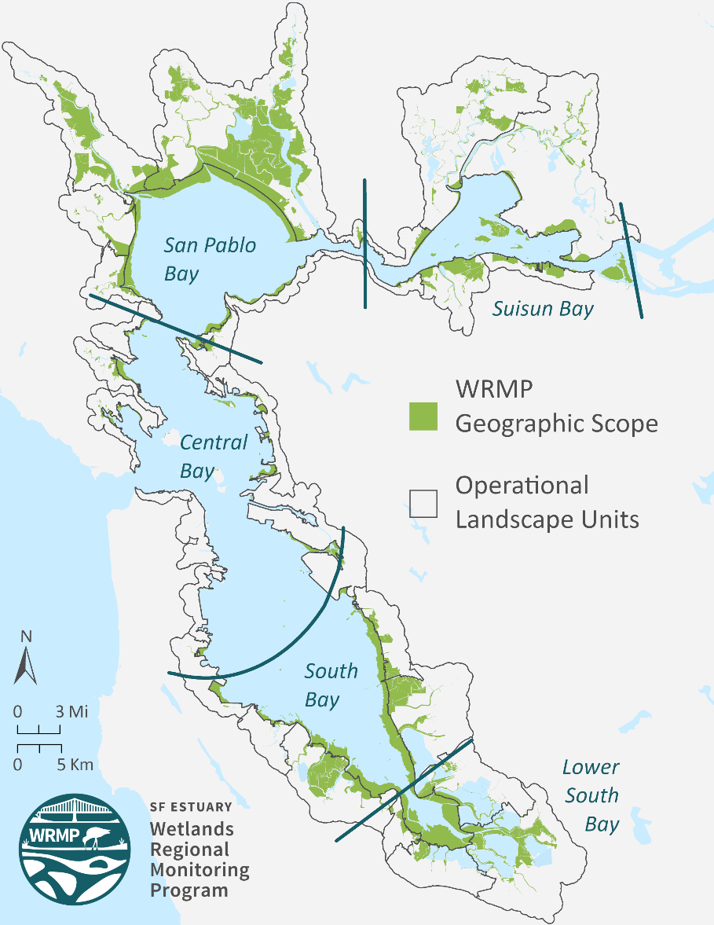
Wetlands Regional Monitoring Program
“The WRMP improves wetland restoration project success by putting in place regional-scale monitoring increasing the impact, utility and application of site specific permit-driven monitoring to inform science-based decision-making. ”
from WRMP website

Slide 41
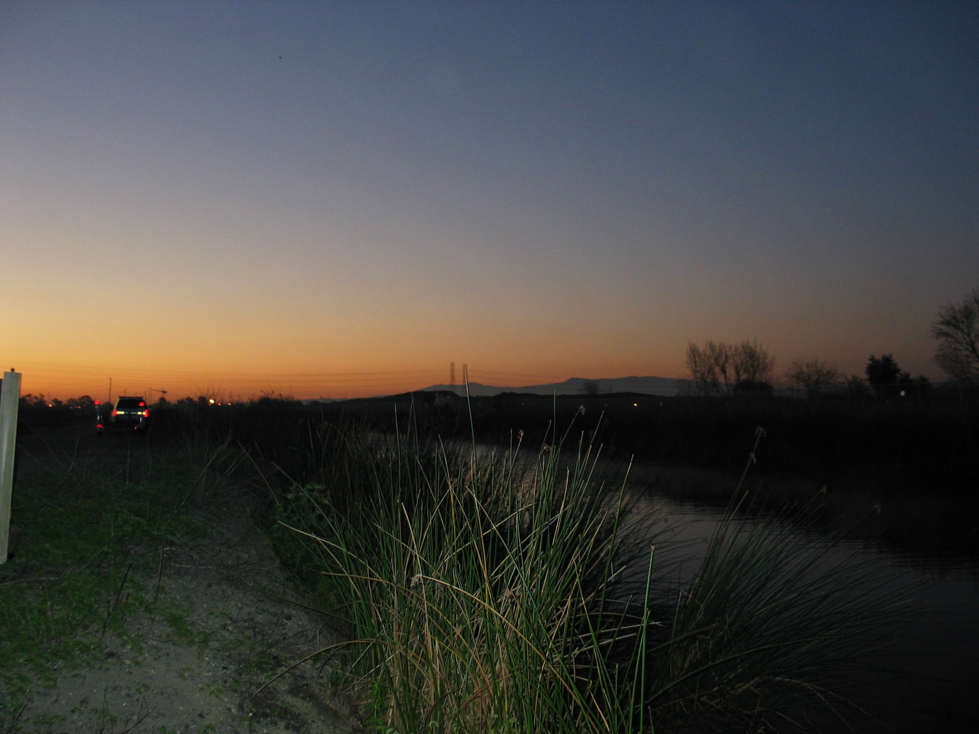
Take Homes
Clearly connect models and monitoring to management questions, with regular review
No single model or monitoring program answers every question
Integration is valuable but challenging: do it for a reason
Identify restoration uncertainties upfront and use these to guide research and monitoring
Outside review can be very useful

Slide 42
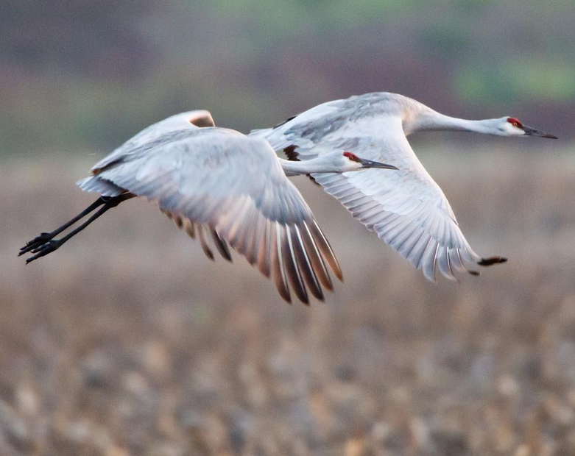
Questions?
callaway@usfca.edu

