Slide 1

Queen Anne’s County
Fiscal Foundation & Future
January 9, 2025
Board of County Commissioners
James J. Moran, At Large
Jack N. Wilson, District 1
J. Patrick McLaughlin, District 2
Philip L. Dumenil, District 3
Christopher M. Corchiarino, District 4

Slide 2
Topics
Financial Stability
Prior Year Outcomes
Where Are We Today?
How Do We Compare?
Forecasts and Projections

Slide 3
Financial Stability

Slide 4
Financial Management
Practices
Quarterly Reporting of Financial Status to Board of Commissioners and/or the Spending Affordability Committee
Regular Projections of Revenues & Expenditures
Regular Updating & Reporting of Long-Range Operating Forecast
Strict Compliance with GAAP, 24 Year GFOA Award for Financial Reporting Recipient
Strong Multi-year Planning via Long Range Capital Improvement Program

Slide 5
Rainy Day Fund
Re - Established in 2013
Contingencies of an Emergency Nature
One-time expenses
Requires Annual Reports on Fund Balance
Surplus Revenues used to Maintain Minimum Balance
Minimum Amount of the Fund is 8% of Budgeted General Fund Operating Revenues
Revenue Stabilization Fund
Established in 2016 by Resolution
Unanticipated Revenue Shortfalls
One Time Expenses
Funded by Transfer from General Fund not to Exceed $1 Million each Year
Maximum amount not to exceed 5% of budgeted General Fund operating revenues
Transfer made after Rainy Day Funding has been met

Slide 6
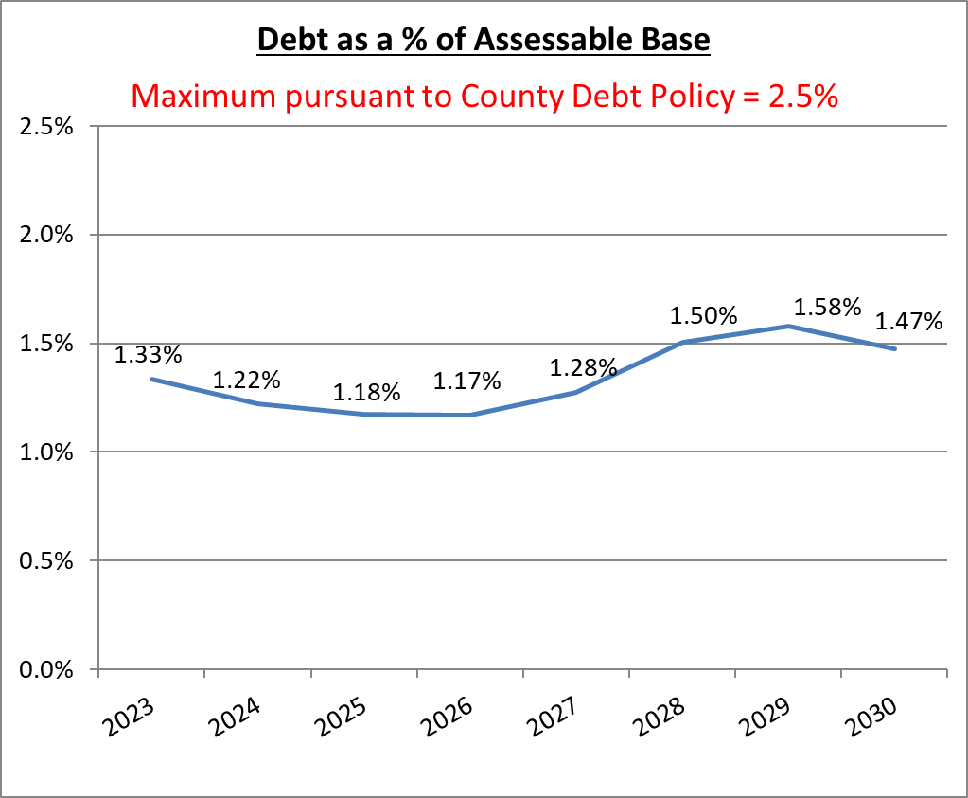
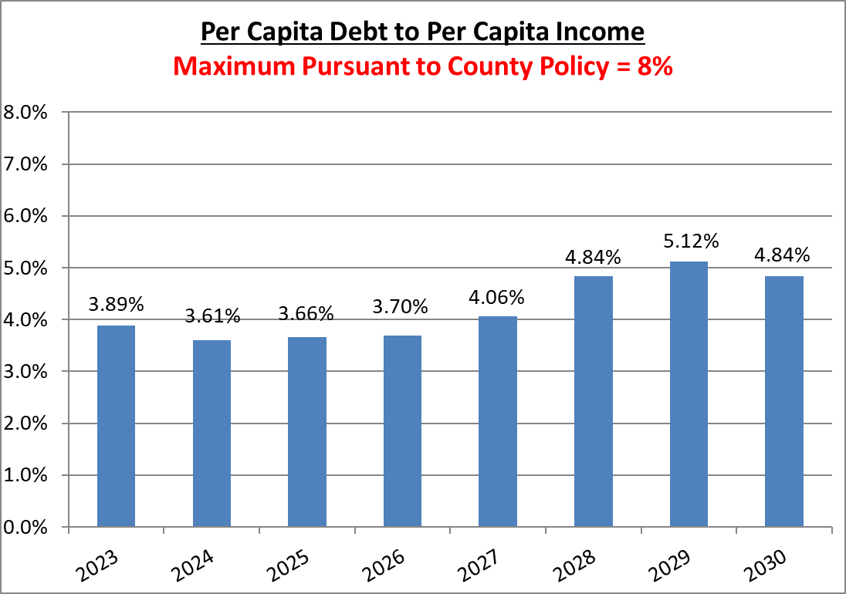
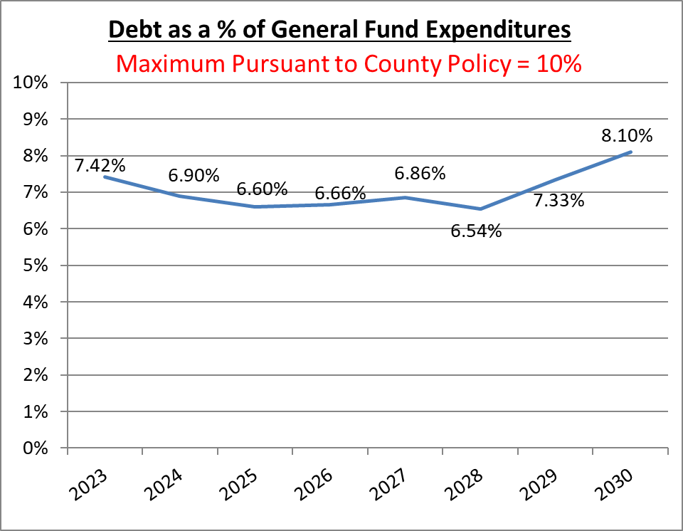
Debt Policy
Before Issuance of Bonded Indebtedness, ensure Outstanding General Bonded Debt is:
2.5% or Less than Total Taxable Assessable Base
Per Capita Debt to Per Capita Income is less than 8%
Less than 10% Debt Service to Total General Fund Expenditures
Established in 2009, Updated in 2013
Prepare 6 Year Capital Improvement Plan by Funding Source
Budget can include Transfer from General Fund to General Capital Fund
Current Bond Ratings:
Fitch Ratings: AAA
S&P Global Ratings: AAA
Moody’s: Aa1

Slide 7
Prior Year Outcomes

Slide 8
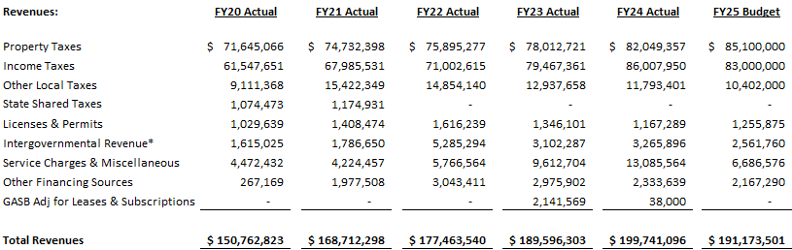
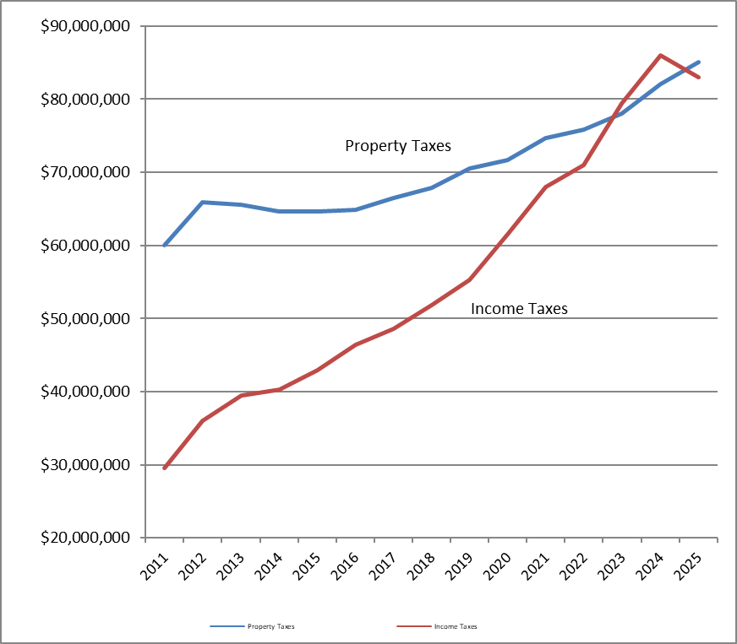
General Fund Revenue
Property and Income Tax Revenue made up 84% of the total General Fund revenues in FY24.

Slide 9
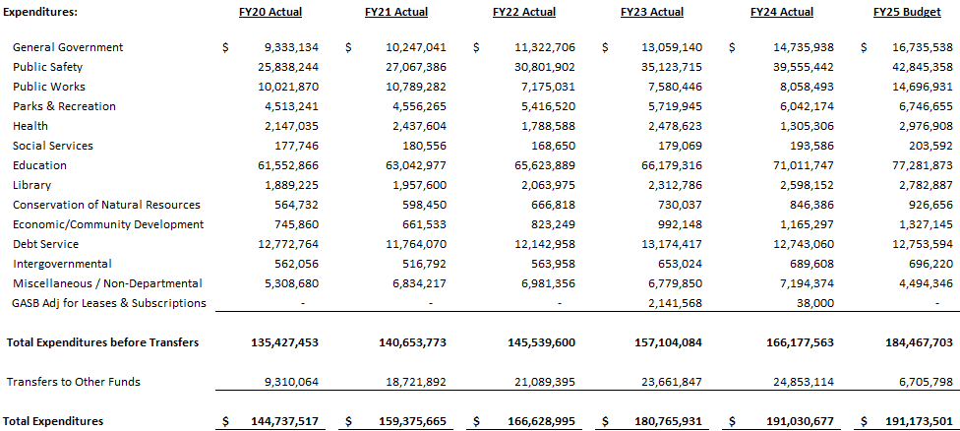
General Fund Expenditures
Education Expenditures (Public Schools and Chesapeake College) made up 43% of total County expenditures in the FY25 budget. *Includes associated debt service.

Slide 10
Where Are We Today?

Slide 11
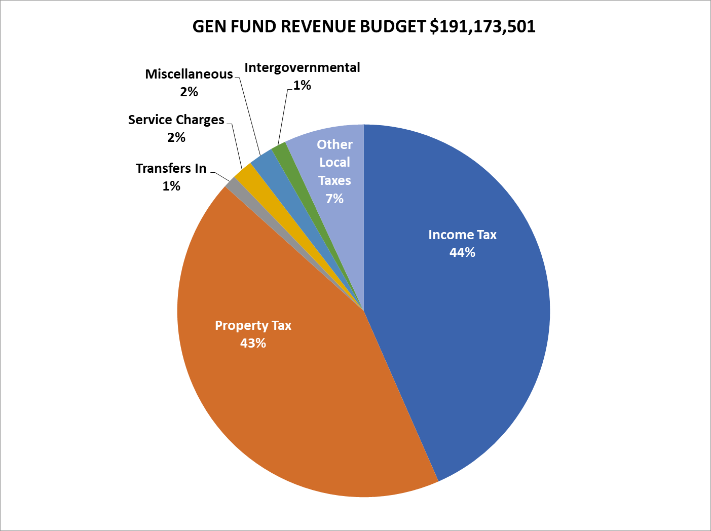
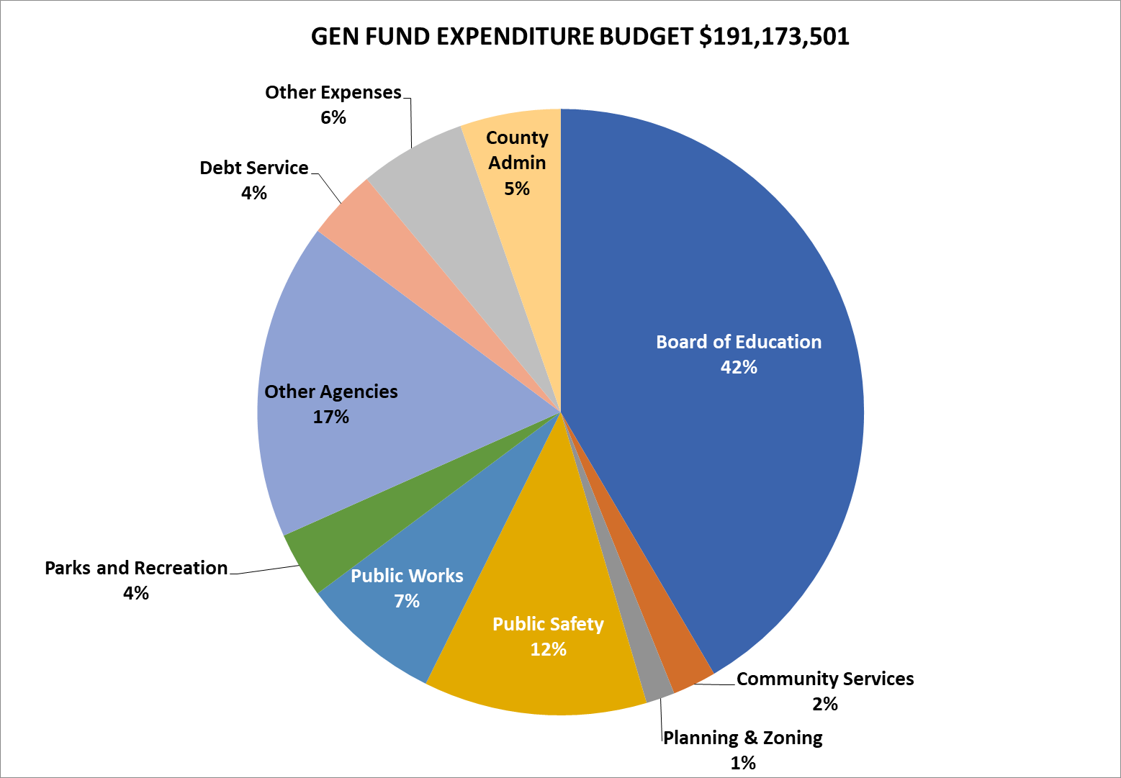
Where Do Revenues Come From?
Where Do We Spend?
Revenues
No Increase in Property Tax or Income Tax Rates
$10.1 Million Total Growth
Income Tax Revenue Increase $6.5 million
Property Tax Revenue Increase $4.0 Million
Expenditures
Funding for Obligated Debt Service
$7.0 Million Increase in Board of Education Funding above Maintenance of Effort
3% Cost of Living Increase for Employees
$2.0 Million Increase For Public Safety and Health Services

Slide 12
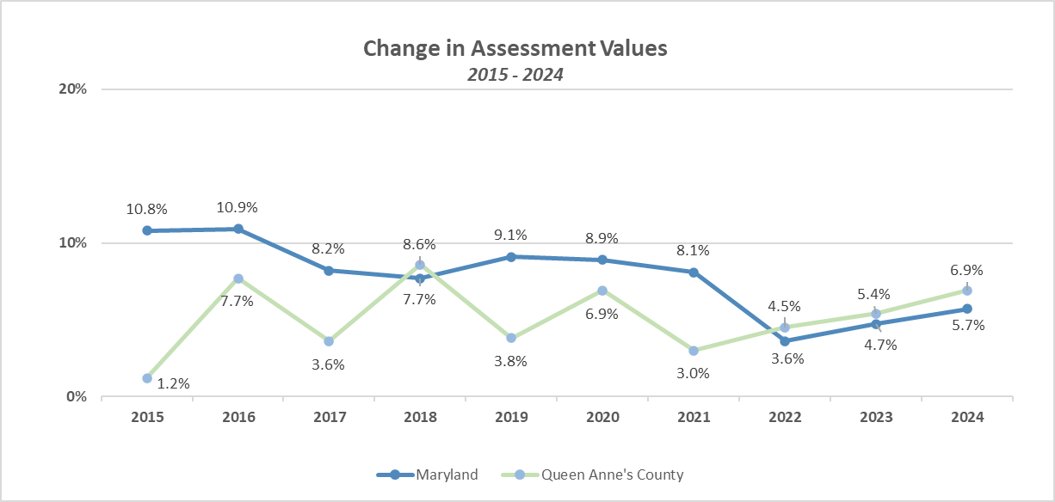
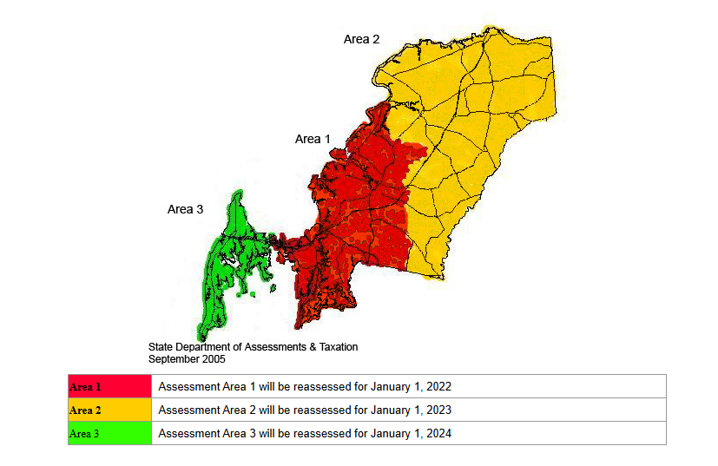
Real Property Assessed Value
Assessment Valuation Notes:
Assessments are conducted by the State Dept of Assessments & Taxation, an “independent” valuator. The County has no role in conducting the assessments.
One-third of all properties are assessed each year, so any one property is only re-evaluated every three years.
Any increase in assessment is phased-in over a three-year period. Further, if the real property is a principal residence, the annual increase is capped at 5% by the Homestead Tax Credit.

Slide 13
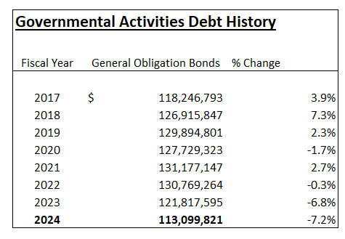
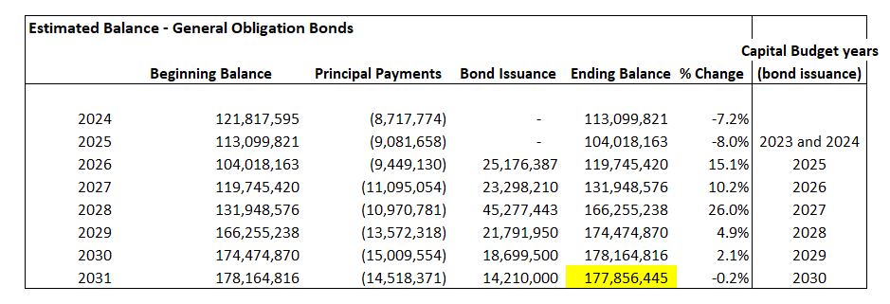
General Obligation Debt

Slide 14
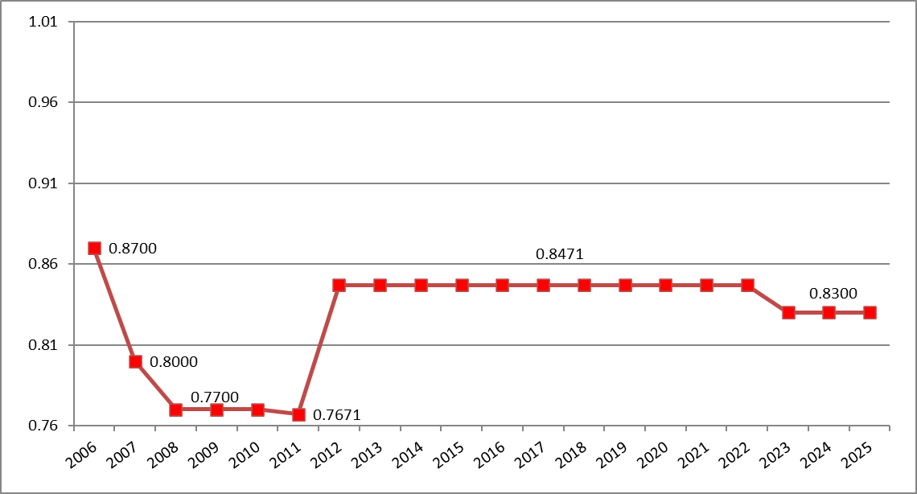
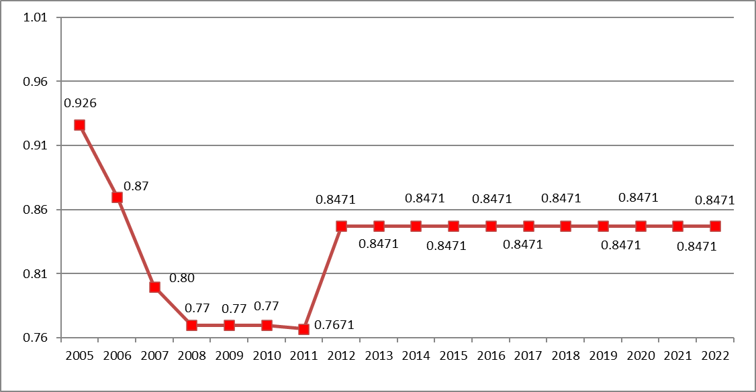
Real Property Tax Rate

Slide 15
How Do We Compare?

Slide 16
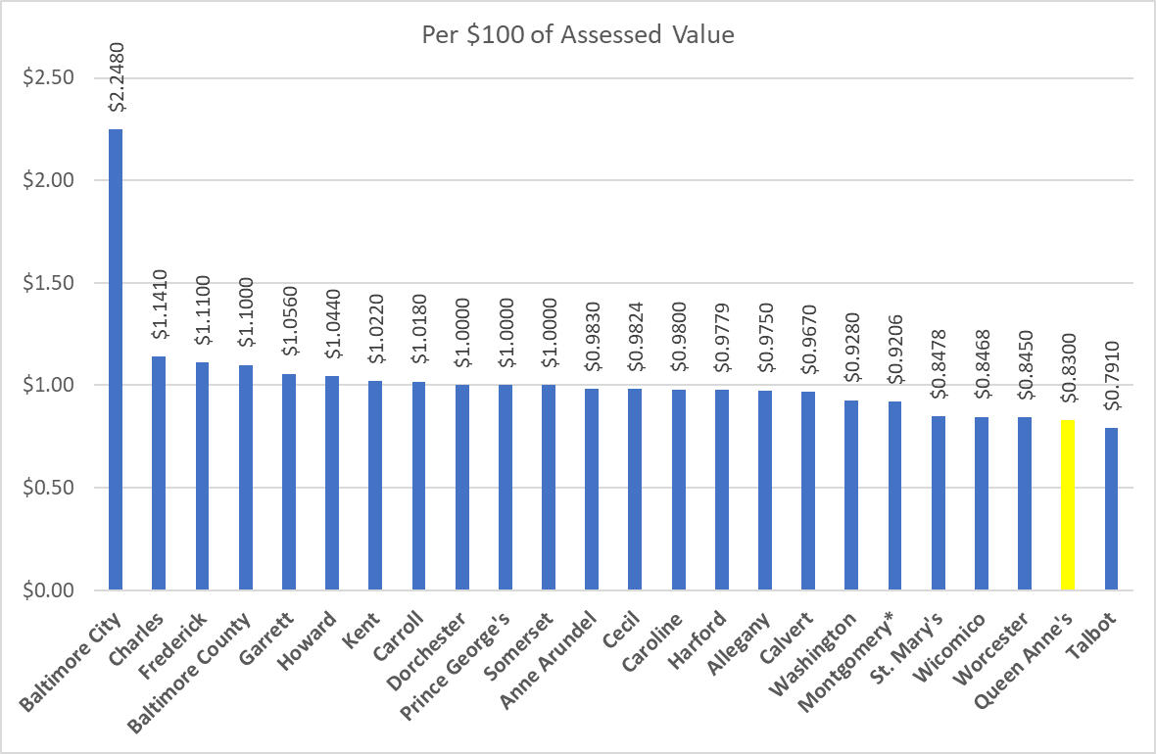
Real Property Tax Rates - Statewide

Slide 17
Per Capita Income
^{5th}
Highest
in the
State
(Dollars)
4th Highest
in the
State
(5-yr growth)

Slide 18
Unemployment Rate Eastern Shore Counties
Source: Maryland Department of Labor, Licensing and Regulation
Queen Anne’s County has had lowest unemployment rate on the Eastern Shore for over 10 years.

Slide 19
Dependency on State Funding
This table shows percentage of each County’s General Fund Budget that is funded by the state
Shows exposure each County has to state budget cuts to health, transportation, and public safety grants and formulas. Funds which can be cut (and have often been cut in the past):
  Highway User Revenues
  Local health formula
  Elderly & Disabled transportation grants
  Police Aid
  Fire & Rescue Aid
  Various capital grants for construction projects
The state can also increase expenses that it charges to counties, such as charges for operating:
  Local health department
  Local social services department
  Court-related expenses
  Cost of operating the local Dept of Assessments & Taxation office
Note – this does NOT include funding for local boards of education, community colleges, or libraries. Due to complicated formula-funding this makes comparisons difficult.
Source: General Assembly of Maryland, Dept of Legislative Services

Slide 20
Forecasts & Projections

Slide 21
What Drives County’s Economy and Fiscal Conditions?
Population Growth
Who are we attracting?
Workforce growth
Economic Growth
Job growth
Types of jobs
Procurement
Real Estate
Residential
Non-Residential
Personal Income Forecast

Slide 22
FY25 Estimates & FY26 Forecast Assumptions
FY25 Year-End Estimates
2.1% Increase in Revenue compared to FY24 Actuals
No Increase in Property Tax or Income Tax Rates
9.0% Increase ($6.2 Million) in Board of Education Funding
Revenue forecasted at 6.7% above FY25 adopted budget
FY26 Forecast Assumptions
Funding for Obligated Debt Service, including future debt issuance projections
$6.5 Million increase for Board of Education Funding
5% Average COLA & Pay For Performance for Employees
9% Increase in Health Insurance Costs
3% Increase in Operating Costs
OPEB Contributions per 10-year plan
Property Tax Revenue Increase 5% above FY25 est. actuals
Income Tax Revenue Increase 5% above FY25 est. actuals

Slide 23
FY25-30 Revenue Forecast

Slide 24
FY25-30 Expenditure Forecast

Slide 25
Potential Challenges
Potential Structural Issues
Funding Blueprint without considering an overhaul to current systems
Funding major construction projects during period of high interest rates and relatively high inflation
Funding increasing healthcare costs and state-mandated benefit costs
Potential Inter-Governmental Funding Issues
How will state’s projected $2.7 Billion deficit affect the County?
  HUR? Police Aid? County funding for state agencies? State’s share of education funding?
Federal funding from and to various departments and programs may be affected by the new administration’s decisions
  Transportation funds / Aging and social program funds / FEMA & disaster preparation funds
Income Tax Revenues
Queen Anne’s County is more dependent on income taxes generated from residents who are government employees than most other counties.
  How will state cuts affect state employee residents?
  What changes will the new federal administration bring to the status of the ~1,200 federal employes and x number of federal contractors who reside in the County?

Slide 26
Major Potential Projects on the Horizon (FY26 to FY2030)
Regional Detention Center - $ 25,335,000
Recreation Center - $ 20,000,000
Historic Courthouse - $ 10,000,000
Animal Services Building - $ 6,250,000
Queen Anne’s Tech Center at Chesapeake College - $ 4,077,663
Playground Equipment - $ 5,615,111
Sheriff’s Office Building - $16,000,000
QACHS Addition Study/Design/Constr. - $ 4,140,000
KIHS Addition Study/Design/Constr. - $ 4,140,000
Trail Dev/Maintenance - $ 3,300,000

Slide 27
Stay Informed & Participate
We post all financial updates / reports / policies / presentations
  https://qac.org/417/Budget-Finance
All budget work sessions recorded and associated working documents are posted
  https://qac.org/587/Budget-Section
Annual Comprehensive Financial Reports (2008 to current)
  https://qac.org/584/Accounting-Section
Attend our budget public information meetings
  Monday, May 19 – Kent Island Library
  Tuesday, May 20 – Liberty Building, 107 N Liberty St, Centreville
  Wednesday, May 21 – Sudlersville Middle School
Contact Us:
Jeff Rank
Director of
Budget & Finance
jrank@qac.org
(410) 758-0414 x2081

